Slide 1
Promotion of Technology-based Start-ups for Innovation-driven Economy
Jung-wha Han, Ph.D
President of SME Policy Studies Association
Chairman of Asan Nanum Foundation
Distinguished Professor, School of Business, Hanyang University

Slide 2
Why Does Korea Need Transformation of SME and Start-up Policy Now?

Slide 3
Dilemma of Korean Economy(1)
Limit to Growth of Major Industries
Positioning in mature and oversupply sectors in global market
Politically strong labor union
Widening wage gap between large corporation and SMEs
Zero-sum Game in Mature Domestic Market
Competition between large corporations and microbusiness in local market
Increasing failures of microbusiness and poverty level of society
Increasing household debt and decreasing domestic purchasing power
Rent-seeking and Collusion among Key Stakeholders
Prevalent rent-seeking behavior for getting license from the government
Exploiting regulatory power of government
Implicit collusion between established stakeholders

Slide 4
Dilemma of Korean Economy (2)
Low Birthrate
Decreasing of working population
Decreasing of consumption
Threat of deflation
Coming of Aged Society
Decreasing of working population
Increasing burden of national pension
Increasing burden of medical expense
Limit to Korean Growth Model
High dependence on overseas market
Growth without employment increase
Disappearance of population growth and construction boom effect

Slide 5
New Challenge and Crisis
4th Industrial Revolution and Digital Transformation
US-China Trade Dispute
Korea-Japan Trade Dispute
Crisis of Political Leadership

Slide 6
Transformation of SME Policy for Revitalization of Korean Economy

Slide 7
Transformation of Korea SME Policy(1)
Building Open Business Ecosystem through Chaebol Reformation
Enhance Flexibility of Employment through Reformation of Labor Union
Expand Market through Reformation of Regulatory System
Vitalization of Technology-based Start-ups to Cope with the 4th Industrial Revolution
Dealing with the Threat of US-China Trade Disputes and Exploit the Momentum

Slide 8
Transformation of Korean SME Policy(2)
Rebuilding the Korea-Japan Cooperative Relationship in Global Value Chain
Stabilization of Micro Businesses through Vitalization of Regional Market
Promotion of Region-based Competitive SMEs
Encouraging Entrepreneurship and Start-ups through University Transformation
Enhancing the Fairness and Expertise in Screening Policy Support

Slide 9
Vitalization of Innovative Startup Ecosystem
Expand
market
Support
technology
commerciali-zation
Reduce
cost of
failure
Innovative
startup
ecosystem
Enhance
entrepreneur
capabilities
Promotefair
trade
Increase
investment

Slide 10
Expand the Market
Increase pubic procurement of innovative products made by startups
Effective government support to export of SME products
Cooperative entry with large companies and SMEs into overseas market
Deregulation for expanding the innovative product market
Change from positive to negative regulatory system

Slide 11
Increase the Investment
Expand the public and private fund of funds
Expand the angel investment
Promote the crowd funding market
Promote the accelerators
Tax credit for M&A of innovative startups
Reduce the transfer income tax for the exit companies

Slide 12
Support Technology Commercialization
Public R&D subsidies to promote the commercialization of technological innovation
Increase equity-based financing for technology-based start-ups
Strengthen the role of private investors in start-up financing market
Transform the universities to the entrepreneurial organization
Change the university evaluation criteria to promote the creation of start-ups

Slide 13
Promote the Fair Trade
Monitor the unfair trade between the large corporations and SMEs
Speed up the compensation for damage caused by unfair trade
Increase the application of exemplary damages to unfair trade
Increase the penalty for stealing technology from the SMEs

Slide 14
Reduce the Cost of Failure
Increase the exemption of joint guarantee liability for
startup entrepreneurs
Decease the tax burden for the entrepreneurs restarting from the failure
Increase the scope of exemption for the asset in case of bankruptcy
Support the restart of entrepreneur in failure
Reduce the stigma effects

Slide 15
Enhance the Entrepreneurial Capabilities
Increase the opportunity for entrepreneurial education and training
Innovate the system of entrepreneurial education
Strengthen the practice-oriented entrepreneurial training program
Develop the effective system of training of trainers(ToTs)
Increase the opportunity of mentoring and consulting

Slide 16
Case of TIPS
Tech-Incubator Program for Startups

Slide 17
Problems in Promoting Technology-based Startups in Korea
Excessive preference to secure job opportunity
Avoidance to startup by the high-potential scientists and engineers
Difficulty to cross over the death valley due to undercapitalization for technology-based startups
Low success rate of commercialization of innovative technology
High personal cost of business failure

Slide 18
Solutions to the Problems
Private investment-driven technology-based startups
Screening of startups by the accelerators established by successful entrepreneurs and leading venture capitalists(not by the government)
Equity-based financing and the government matching
R&D subsidy and support for overseas marketing for 3 years

Slide 19
History of the TIPS
Started in 2013(5 operating companies, 15 startups)
Opened the TIPS town at Gangnam, Seoul in 2015
Introduction of Post-TIPS in 2018
41 operating companies and 679 startups by the end of 2018.

Slide 20
Process of Operating TIPS
Government selects the TIPS operating companies and gives them the right to recommend startups for the government support.
Operating companies select the high-potential startups and invest about 100 thousand US dollars, and then recommend for the government screening.
Selected startups receives incubating and mentoring service with R&D subsidy of 420 thousands US dollars and startup fund of 80 thousand US dollars, overseas marketing support of 80 thousand US dollars and additional 160 thousand US dollars as matching investment by the government.
Among the TIPS-supported startups, some are selected according to the performance for global scale-up and receive additional 420 thousand US dollars(Post TIPS).

Slide 21
BuB B
·Program Budget (2013~2019)
US $ : million
Criteria
2013 2014 2015 2016 2017 2018 2019
Total
R&D
2.6
20.7
20.7
40.7
53.3
72
105.6
307.5
(6)
(6.2)
Startup Support
Oversea Marketing
-
-
4.9
-
4.4
-
5.2
5.2
13.3
8.9
14.3
13.3
6.1
53.8
28.9
9.2
Post-TIPS
-
-
-
-
-
13.4
8.6
21.5
(13.4)
(12.9)
Pre-TIPS
-
-
-
-
-
-
-
-
-
-
1.7
1.7
3.6
3.4
Operation of TIPS Town
9.1
12.3
Total
2.6
25.6
25.1
51.2
73.9
119.9
(19.6)
139.1
427.6
(18.9)
ⓒ 2019. (Korea Business Angels Association) all rights reserved
13

Slide 22
· TIPS operating companies 41, startup teams 679
2013
4
2014
8
2015
6
2016
8
2017
9
2018
6
Total
41
 | 2013 | 2014 | 2015 | 2016 | 2017 | 2018 | Total
Incoming Operating Companies per year | 4 | 8 | 6 | 8 | 9 | 6 | 41
Selected Startup Companies per year | 15 | 39 | 79 | 85 | 205 | 256 | 679
Incoming Operating Companies per year
선정 창업팀
15
39
79
85
205
256
679

Slide 23
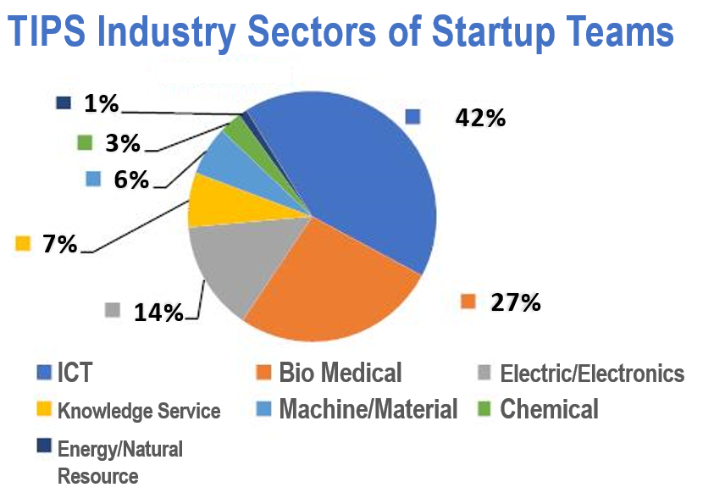
ⓒ 2019. (Korea Business Angels Association) all rights reserved
14

Slide 24
TIPS Program Performance ( 2018 )
Cumulative Total $ 1 B
Private Investment
• Additional Private Investment after selection $ 920M(262 startups, $3.4M per company)
IPO
·
2 IPO (Market cap $ 433M) · 7 M&A ($ 50.6M)
M&A
104 Companies
Overseas
Operation
Increased 5.3 employee per company
Job Creation
• 4,759 total employees
ⓒ 2019. (Korea Business Angels Association) all rights reserved
16

Slide 25
TIPS Program Performance
▪ (TIPS) Background of Startup Founders
TIPS
Educational Background
Master/Doctoral degree: 57%
• 165 Professor, 25 Medical Doctors, 8 Lawyer/Patent Attorney
Research University graduate : 55%
Universities
• 291 from SNU, 213 from KAIST, 20 from Stanford, 11 from MIT
Worked at the large companies : 30%
Companies
• 206 from Samsung, 106 from LG, 56 from SK, 62 from Naver/Daum, 15 from Apple/Google
20 form Intel/MS
ⓒ 2019. (Korea Business Angels Association) all rights reserved
17

Slide 26
Conclusions (1)
Korean government exerted a lot of efforts to promote the high and new technology-based startups for the past 30 years.
She achieved an extraordinary success in terms of numbers, more than 33,000 venture companies now.
However, the scale-up of ventures has not been so successful, particularly in becoming competitive in the global market(572 companies whose revenue exceeds 80 mil. US dollars).
Also she experienced the dysfunction of government sponsorship, for example, problems of moral hazard and adverse selection.
To solve this problem, the government has tried to establish the innovative startup ecosystem.

Slide 27
Conclusions (2)
Innovative startup ecosystem requires; (1) expand market, (2) increase investment, (3) support technology commercialization, (4) promote fair trade system, (5) reduce cost of failure, (6) enhance entrepreneurial capabilities.
TIPS was designed to attract the high potential technology entrepreneurs, including scientist, engineers, and other professionals.
The key success factors of TIPS are as follows; (1) selection of startups by private investors, such as angels, accelerators, and venture capitalists, (2) mentoring and coaching by experienced and successful entrepreneurs, (3) packaged support including matching investment, R&D subsidy, and marketing support to help startups cross the death valley, (4) additional investment by other private and foreign investors. (5) monitoring of healthy operation by the government.

Slide 28
Thank You

