Slide 1
ENTREPRENEURSHIP IN A DIGITAL AND INTERNATIONAL WORLD
SME World Forum 2019, Macao Patrick Schueffel, Rico Baldegger, Pascal Wild

Slide 2
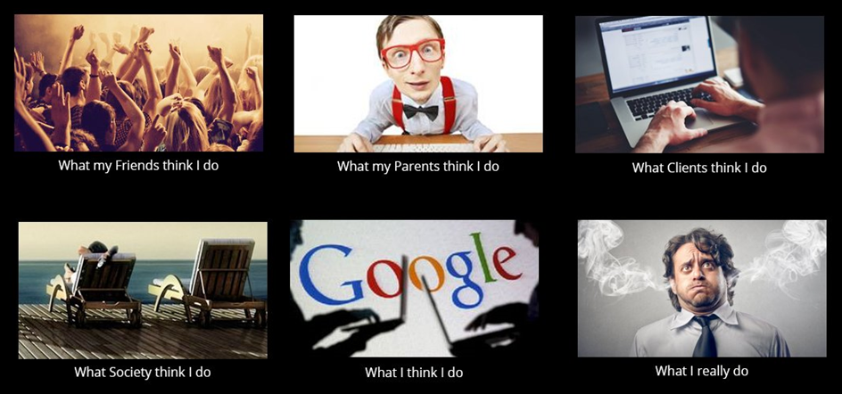
Entrepreneurship in a digital world
HarD To Grasp

Slide 3
Agenda
Presentation Content
BACKGROUND AND RESEARCH QUESTION
PROPOSITIONS DERIVED
MEASURE CONSTRUCTS
RESEARCH MODEL
RESEARCH METHODOLOGY
RESEARCH MODEL AND HYPOTHESES BEFORE AND AFTER TESTS
DISCUSSION OF FINDINGS
LIMITATIONS

Slide 4
BACKGROUND AND RESEARCH QUESTION
The Role of EO in SMEs
Large bodies of literature exists on the antecedents of and outcomes of
Entrepreneurial Orientation (EO)
SME internationalization
but much less literature exists describing the EO-Internationalization linkage
and even less on the EO-Digitization relationship
Digitization: «the main driver of innovation and change in all sectors of our economy» (Kagermann, 2015)
Research Problem:
How does EO affect the Digitization of an SME?
… and its internationalization?
… and its performance?

Slide 5
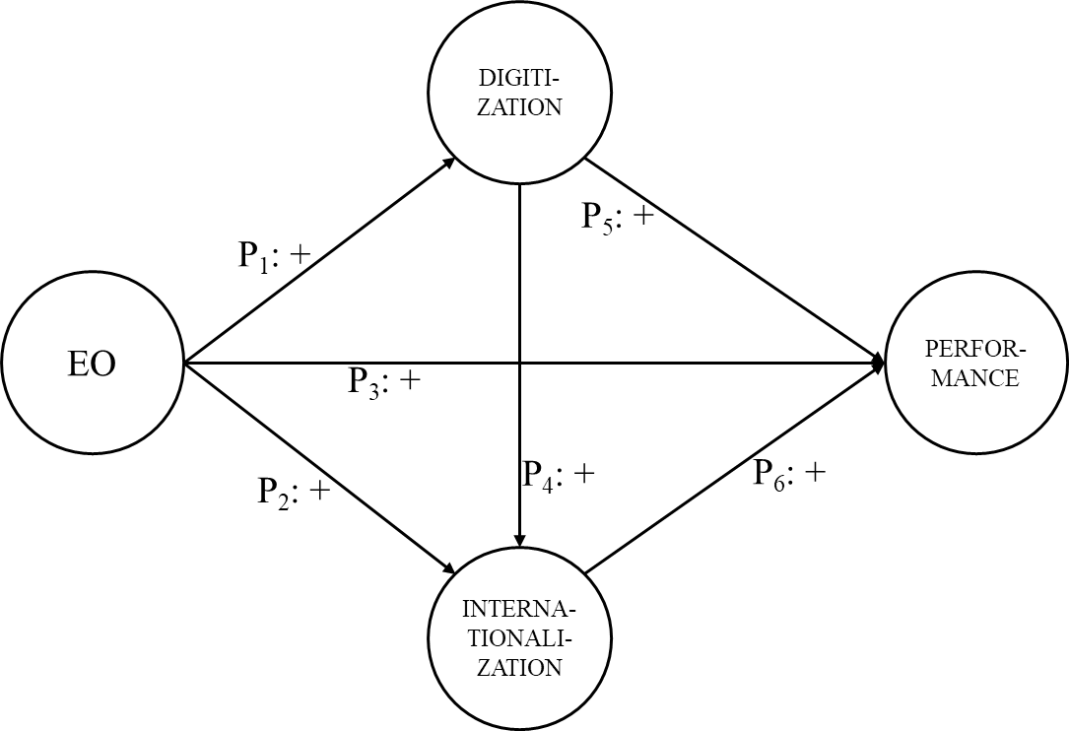
Propositions derived
Mapping Antecedents and Outcomes
P₁: The more pronounced the EO of a firm is, the larger is its degree of digitization
P₂: The more pronounced the EO of a firm is, the more international is its
P₃: The more pronounced the EO of a firm is, the better is its performance
P₄: The larger the degree of digitization of a firm is, the more international it is
P₅: The larger the degree of digitization of a firm is, the better is its performance
P₆: The more international a firm is, the better is its performance

Slide 6
Measures
Variable Definition
Dependent variables
Digitization: four-item scale (Greif, Kühnis, & Warnking, 2017)
Internationalization: three-item scale, consisting of
No of continents (Luostarinen & Gabrielsson, 2006; Kuivalainen, Saarenketo, & Puumalainen, 2012)
No of countries (Stopford & Wells, 1972; Sullivan, 1994)
Percentage of International Sales (Lu & Beamish, 2006; McDougall & Oviatt, 1996)
Independent variables
EO: nine-item scale (Covin & Slevin 1989; Miller & Friesen 1983; Khandwalla 1977)
Performance: eight-item scale (Eddleston, K. A., Kellermanns, F. W., & Sarathy, R., 2008)
Control variables
Gender (Aidis, Welter, Smallbone, & Isakova, 2007; Estrin & Mickiewicz, 2011)
Age (Audretsch, 2012; Lafuente & Vaillant, 2013; Lévesque & Minniti, 2011)
*as of year one after internationalization start

Slide 7
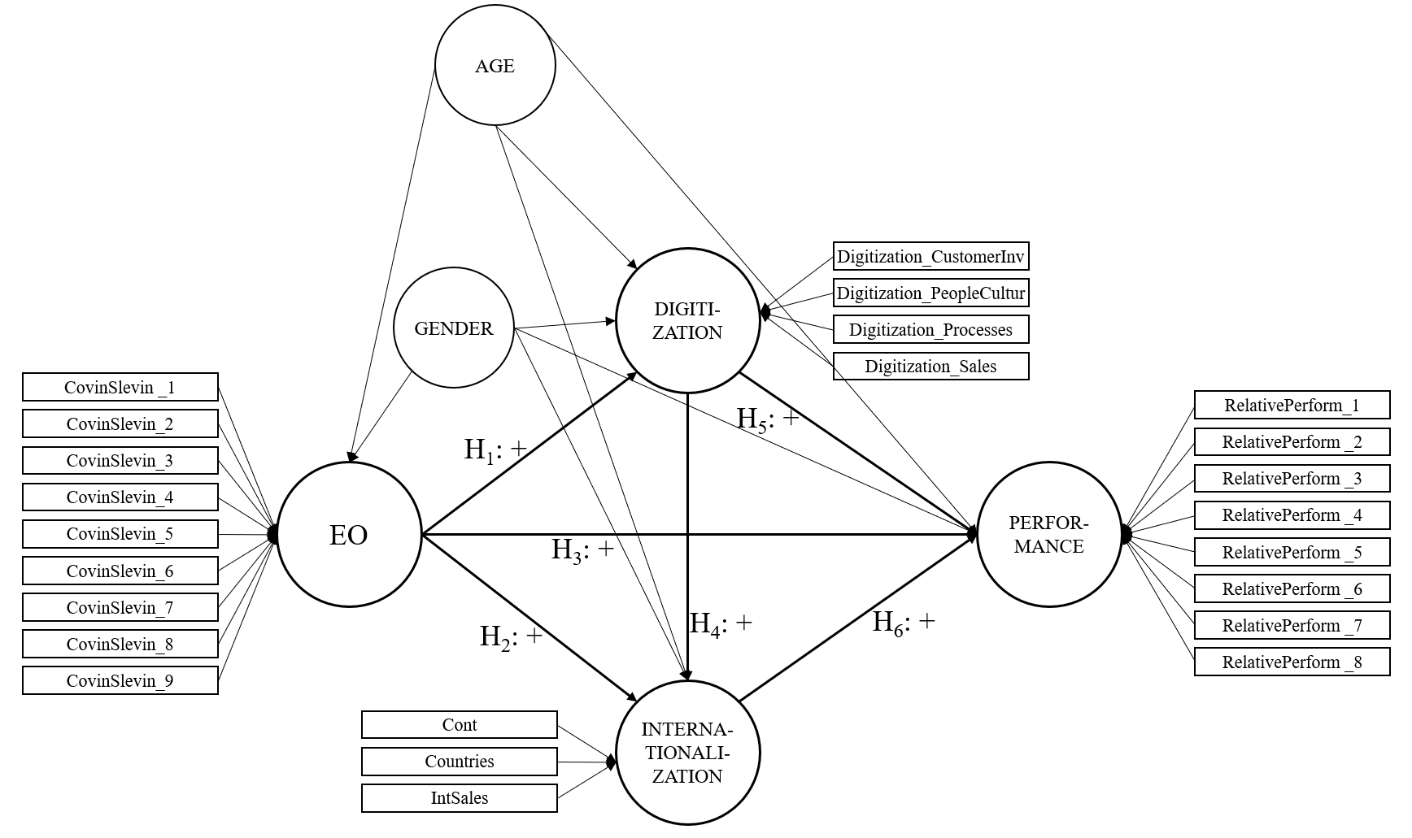
RESEARCH MODEL
And Measure Constructs

Slide 8
RESEARCH METHODOLOGY
Methods Applied
Research type
Hypotheses testing, hence quantitative approach
Mixed types of variables, non-normal distributed: Partial Least Square (PLS) analysis
Data collection
Combined mail and Web-based survey approach
Year end 2018 was set as the reference point for the informant
Survey was pre-tested with researchers, SME owners/founders/managers
Sample
Total population of Switzerland-based SMEs (=<250 employees)
Total cohort of exporting SMEs: approx. 45,000 firms
Stratified random sample: 8’000 Switzerland-based SMEs representative for cultural and linguistic regions of Switzerland
Questionnaire was addressed to the CEO as the survey specially demanded high-level knowledge
As incentive CEOs were offered follow-up workshops on the research project
Response rate (usable questionnaires returned): appr. 4.5%

Slide 9
RESEARCH MODEL – AS SUGGESTED
Mapping Antecedents and Outcomes

Slide 10
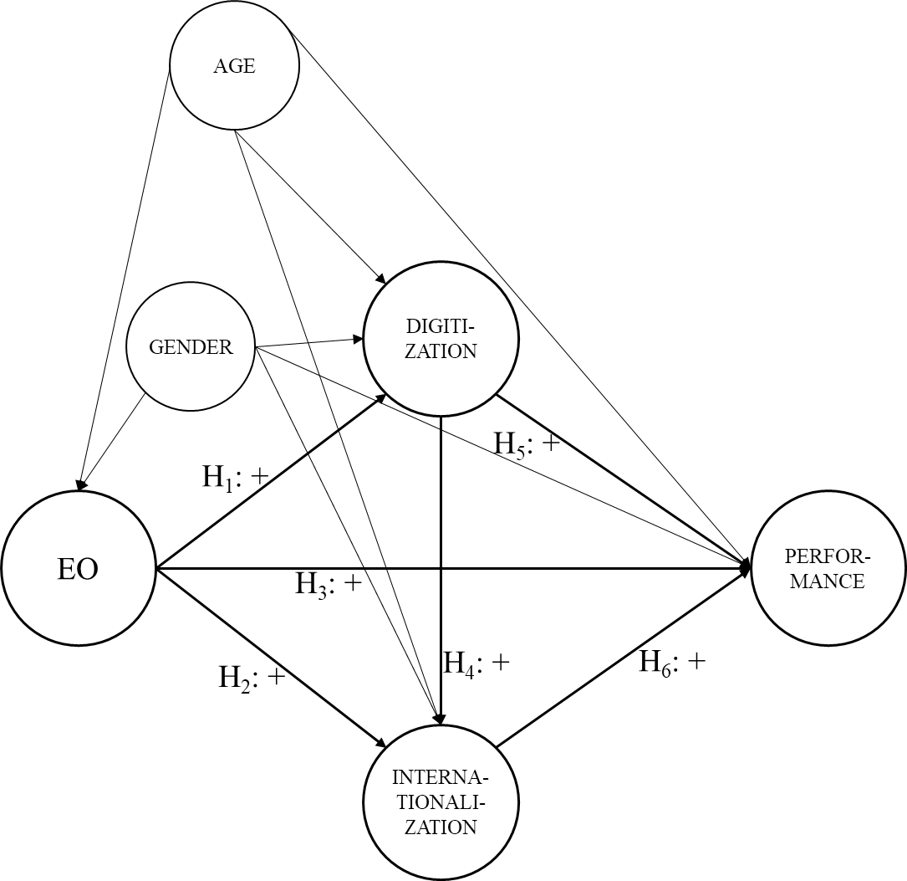
RESEARCH MODEL – AS SUGGESTED
Mapping Antecedents and Outcomes – INCLUDING CONTROL VARIABLES

Slide 11
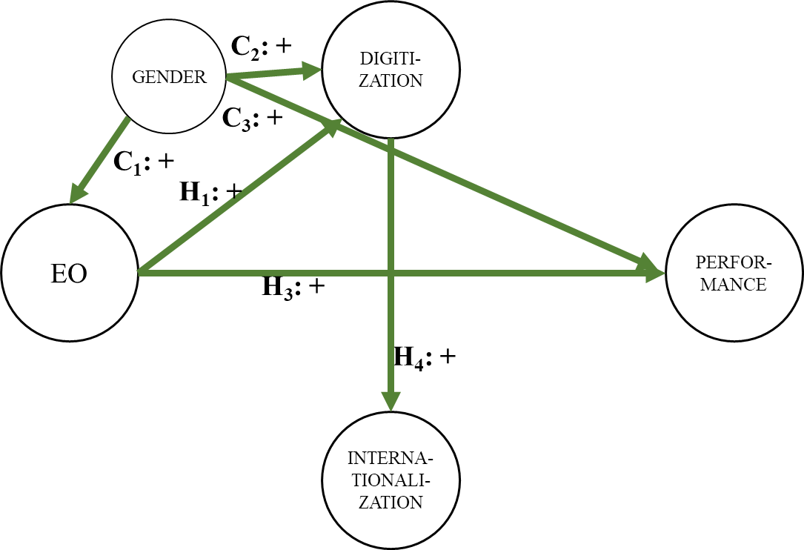
RESEARCH MODEL – AFTER TESTS
CONFIRMED RELATIONSHIPS

Slide 12
HYPOTHESES DERIVED
HYPOTHESES DERIVED
H₁: The more pronounced the EO of a firm is, the larger is its degree of digitization
H₂: The more pronounced the EO of a firm is, the more international is its
H₃: The more pronounced the EO of a firm is, the better is its performance
H₄: The larger the degree of digitization of a firm is, the more international it is
H₅: The larger the degree of digitization of a firm is, the better is its performance
H₆: The more international a firm is, the better is its performance

Slide 13
HYPOTHESES AFTER TESTS
IDENTIFIED RELATIONSHIPS
✓
H₁: The more pronounced the EO of a firm is, the larger is its degree of digitization β=0.753, p<0.05
H₂: The more pronounced the EO of a firm is, the more international is its
H₃: The more pronounced the EO of a firm is, the better is its performance β=0.538, p<0.05
H₄: The larger the degree of digitization of a firm is, the more international it is β=0.501, p<0.05
H₅: The larger the degree of digitization of a firm is, the better is its performance
H₆: The more international a firm is, the better is its performance
C₁: Being male has a positive impact on the levels of EO of a firm β=0.861, p<0.05
C₂: Being male has a positive impact on the degree of digitization of a firm β=0.177, p<0.05
C₃: Being male has a positive impact on the performance of a firm β=0.393, p<0.05
✗
✓
✓
✗
✗

Slide 14
DISCUSSION OF FINDINGS
Entrepreneurial Orientation significantly influences the digitization of a firm
…and its performance!
In turn digitization influences an SME’s internationalization!
BUT
Entrepreneurial Orientation per se does not spur internationalization
And digitization does not increase SME performance
And internationalization does not necessarily improve performance

Slide 15
LIMITATION
Main CONSTRAINTS
Generalizability
A sample of Switzerland-based SMEs was used for our analysis, hence cultural and geographic differences limit the generalizability of the results
Relationships
Relationships identified in this study were based largely on composite constructs
Further insights could be gained by reducing the multidimensionality of these constructs or even investigating individual factors; decomposed factors could yield additional insights
EO Construct
Female respondents yielded lower EO scores than the organizations of male respondents
Doubt emerges as to whether EO is a sufficiently gender-neutral construct measuring the entrepreneurial orientation of an organization or whether it has a too large collinearity with masculinity

Slide 16
Q & A

Slide 17
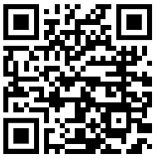
Thank you
For your attention!
Dr. Patrick Schüffel, A.Dip.C., M.I.B., Dipl.-Kfm. Adj. Professor
Liaison Officer Singapore
Institute of Finance
Haute école de gestion Fribourg Chemin du Musée 4
CH-1700 Fribourg
patrick.schueffel@hefr.ch, www.heg-fr.ch
LinkedIn: https://www.linkedin.com/in/patrick-schueffel/

