Slide 1
Joseph Chan
CEO& Founder
AsiaPay
Digital Payment Development in Asia
Hong Kong . Australia . China . India . Indonesia . Japan . Malaysia . Philippines . Singapore . Taiwan . Thailand . Vietnam . United Kingdom

Slide 2
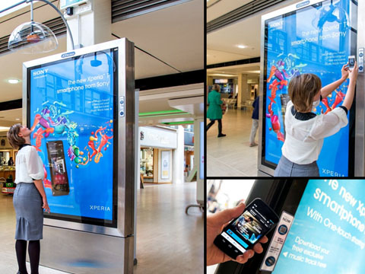
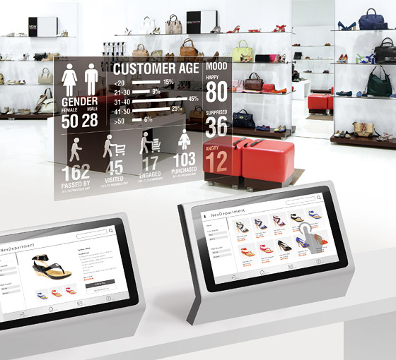
Shoppers in Digital Age

Slide 3
Payment Disruption
Payment
Disruption
M
ETHOD
I
NFRASTRUCTURE
PAYMENT
C
HANNEL
E
XPERIENCE

Slide 4
Alternative Payments in Asia
Payment
Methods
Hong Kong
Australia
China
India
Indonesia
Malaysia
New Zealand
Philippines
Russian
Singapore
Taiwan
Thailand
Vietnam
Global
Net Banking (51 Banks)
*
ATM Cards Payment
etc.
*
* Soon

Slide 5
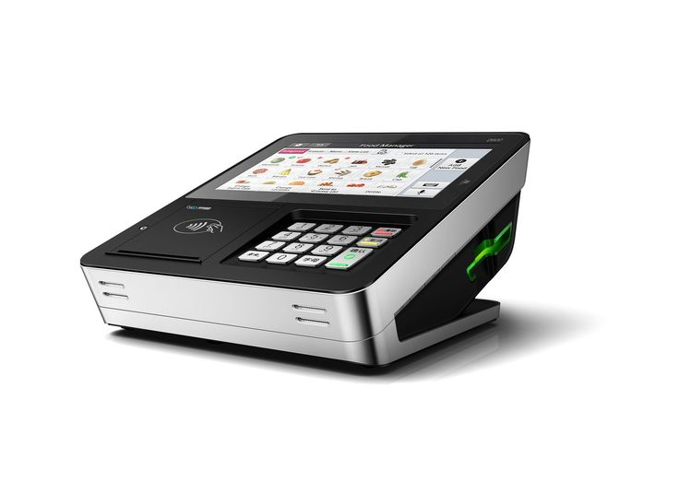
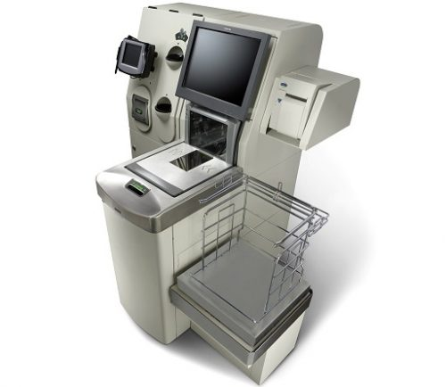
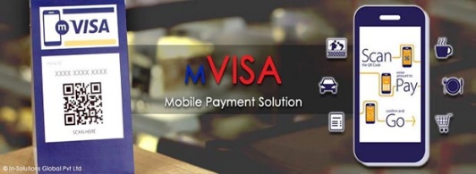
Mobile + Retail Payments
Payment
Experience

Slide 6
Integrated Omni-Channel Payment Management
Payment
Infrastructure
Customers
Merchants
Payment Gateway
Acquirer / Card Schemes
Acquiring Banks
Internet
Merchant Website
Card Capture
Processors
Mobile
PayDollar PayCart / HRMS / ORMS
Smart POS
Payment Gateway - MIGS, MPGS, CyberSource
mPOS
API / Plugins
3-D Secure
Processing
Direct Connection
Credit & Debit Cards
Offline
eWallet
Processing
(Coming Soon)
Bank Account & Net Banking
eMOTO
Currency
Processing
IVRS
Retail Payment
Fraud Control
Others
IOT
Card Tokenization
Multi-currency
Multi-lingual
Multi-user entitlement
Transaction handling
Flexible settlement
Dynamic reportings
Access control
Web / Mobile API
(Cash Counter)

Slide 7
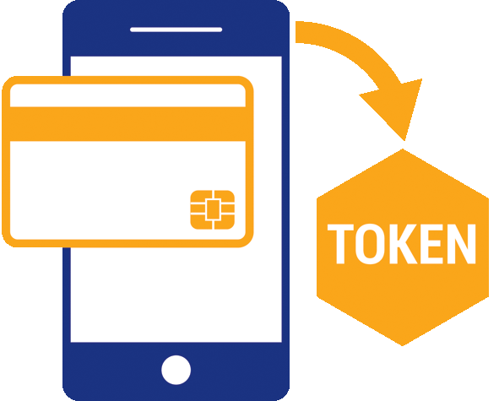
Innovation n Development
Payment
Innovation
FPS/QR
OPEN API
TOKENIZATION
SMART POS
BIOMETRIC
RECOGNITION
3D SECURE 2.0
BLOCKCHAIN
BIG DATA
ARTIFICIAL
INTELLIGENCE
VR / IOT

Slide 8
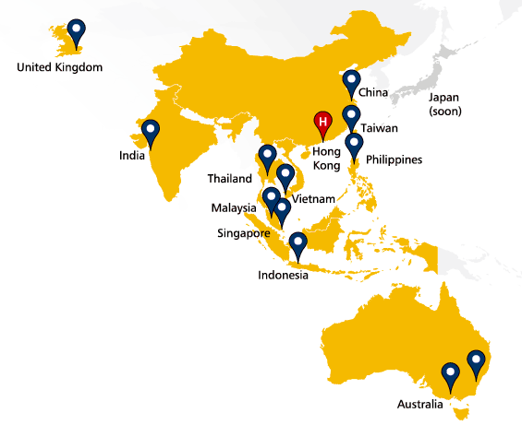
About AsiaPay
About AsiaPay
Leading Digital Payment Service & Technology Provider in Asia since 2000.
13+
Countries
12+
Languages
144+
Currencies
100+
Payment methods & bank partners
PCI DSS Level 1 Compliant since 2006
Certified 3-D Secure
Head Office
Hong Kong
Operative Offices in Asia
15
Professional Workforce
170
Our Vision
To be the leading ELECTRONIC PAYMENT SERVICE AND TECHNOLOGY player in Asia and beyond. Our Mission
To help our business partners grow their business through online by providing innovative, secure and cost-effective solutions that will make them competitive in the eCommerce landscape.
Business Stream
Payment Service Provider (TPP / ISO / PF)
Payment Gateway Solution Provider
Payment Security Solution Product Vendor
eBusiness System Development and Consultancy
Hong Kong . Macau . China . Australia . Singapore . Malaysia . Thailand . Philippines . Taiwan . Indonesia . India . United Kingdom

Slide 9
Bank and Payment Network in Asia
About AsiaPay
Country | Credit / Debit Card Acquiring Bank Partners |  |  |  |  |  | Debit Services | Debit Services
Hong Kong
Australia
China
India |  |  |  |  |  |  | Net Banking (51 banks) | Net Banking (51 banks)
Indonesia
Macau
Malaysia
New Zealand
Philippines
Singapore
Taiwan
Thailand
Vietnam
UK
Others | Bangladesh |  |  | Brunei |  |  |  | Mauritius
 | Pakistan |  |  | Sri Lanka |  |  |  | Global
(Coming Soon)

Slide 10
k
Leading the Way.
Pay with AsiaPay.
SIMPLE  CONVENIENT  SECURE  TRUST

