Slide 1
Entrepreneurship
The Determinants in Contributing the Entrepreneurship Intention for the Youth in Macau
Chan, Ka Man ( Jacob )
City University of Macau

Slide 2
Table of Contents
Entrepreneurship
Motivation
Aim & Objectives
Research Framework
Procedure of Study
Demographic Distribution
Descriptive Result
Correlative Result
Regressive Result
Analysis of Variance
Summary of Results
Recommendations
Future Study

Slide 3
Motivation
The entrepreneurship is emphasized in the modern era.
It has a positive influence on the diversification of the economic structure of Macau.
The new phrase of incubation program was started.
Motivation
Time to Review

Slide 4
Aim & Objectives
Aim: Providing Recommendations to Encourage the Entrepreneurship Intention
To understand the local situation in relation to the intention.
To construct the predictive model.
To give practical recommendations.
Motivation

Slide 5
Aim & Objectives Problem Statements of This Study
What are the suitable Determinants in characterizing the consideration of a young person to start a new venture?
What is the indicator for a person with sufficient entrepreneurial intention?
What are the proposed recommendations and suggestions for the policymakers to boast the intention of the entrepreneurial atmosphere among the young person?

Slide 6
Limitations
High Dependence on the Quantitative Results
Lack of Investigation to the Contributors of Constructs
Lack of Authority in Getting Large Amount of Samples
Motivation

Slide 7
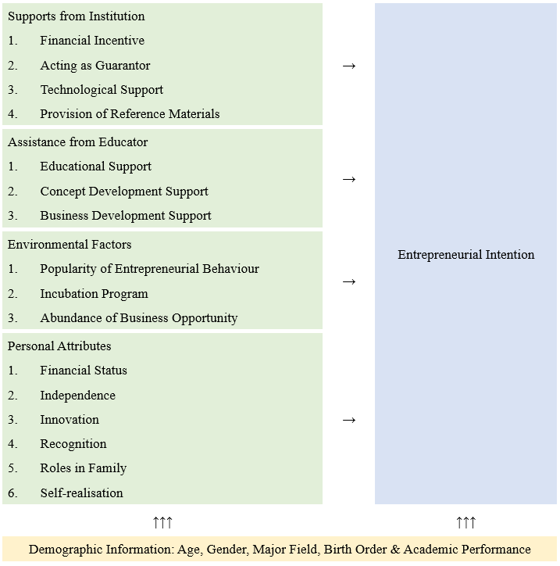
Research Framework
Determinants
Motivation
Outcome

Slide 8
Procedure of the Study
Identification of the Research Question
Development of the Objectives
Seeking the Support from the Existing Literature
Construction of the Methodological Approach in Carrying out the Study
Conducting of the Research Activity
Collection & Clearing of the Data
Analysis of the Data
Drawing Conclusion
Provision of Recommendation
Motivation

Slide 9
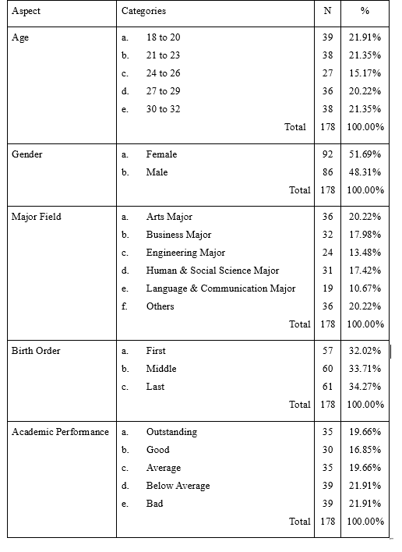
Demographic Distribution
Full Coverage of all Categories
Suitability for Analysis
Suitable!!
Motivation

Slide 10
Descriptive Result
Supports from Institutions
Assistance from Educators
Personal Attributes
Environmental Factors
Motivation

Slide 11
Descriptive Result ( cont. )
Categories of the Determinants & Entrepreneurial Intention
Motivation

Slide 12
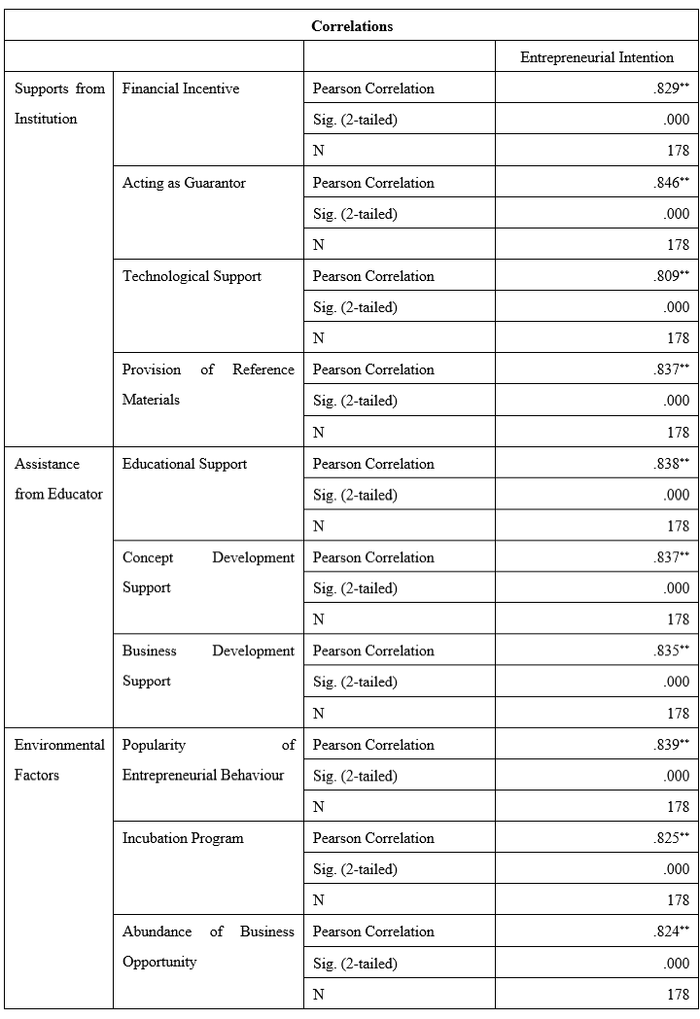
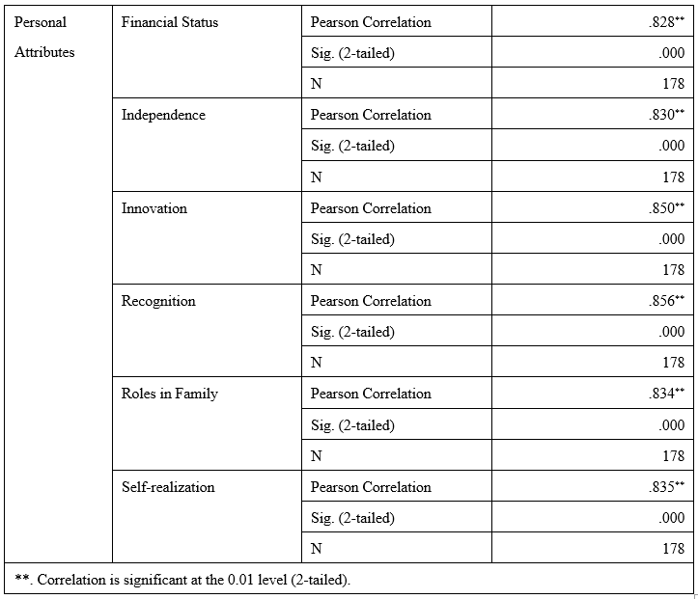
Correlative Result
Motivation
All of Them Correlated!!

Slide 13
Regressive Result
$$Entrepreneurial Intention= 0.051 × Financial Incentive + 0.081 × Acting as Guarantor + 0.094 × Technological Support + 0.086 × Educational Support + 0.139 × Concept Development Support + 0.075 × Business Development Support + 0.086 × Incubation Program + 0.063 × Abundance of Business Opportunity + 0.093 × Independence + 0.075 × Innovation + 0.111 × Recognition + 0.140 × Roles in Family + 0.072 × Self−realization − 0.663$$
Provision of Reference Materials
Popularity of Entrepreneurial Behaviour
Financial Status
Excluded
Motivation

Slide 14
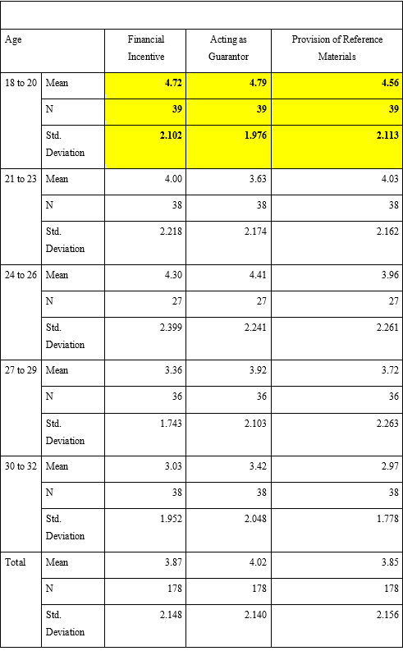
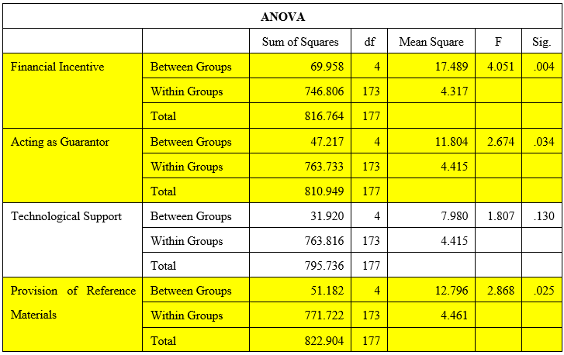
Analysis of Variance (Age)
Supports from Institutions
Motivation

Slide 15
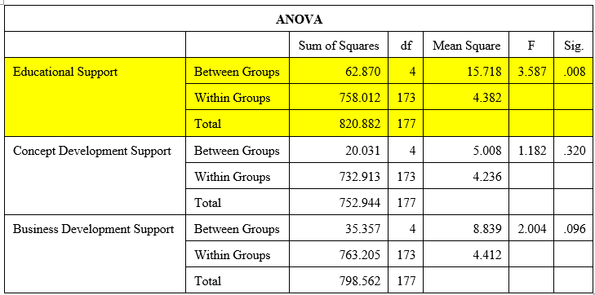
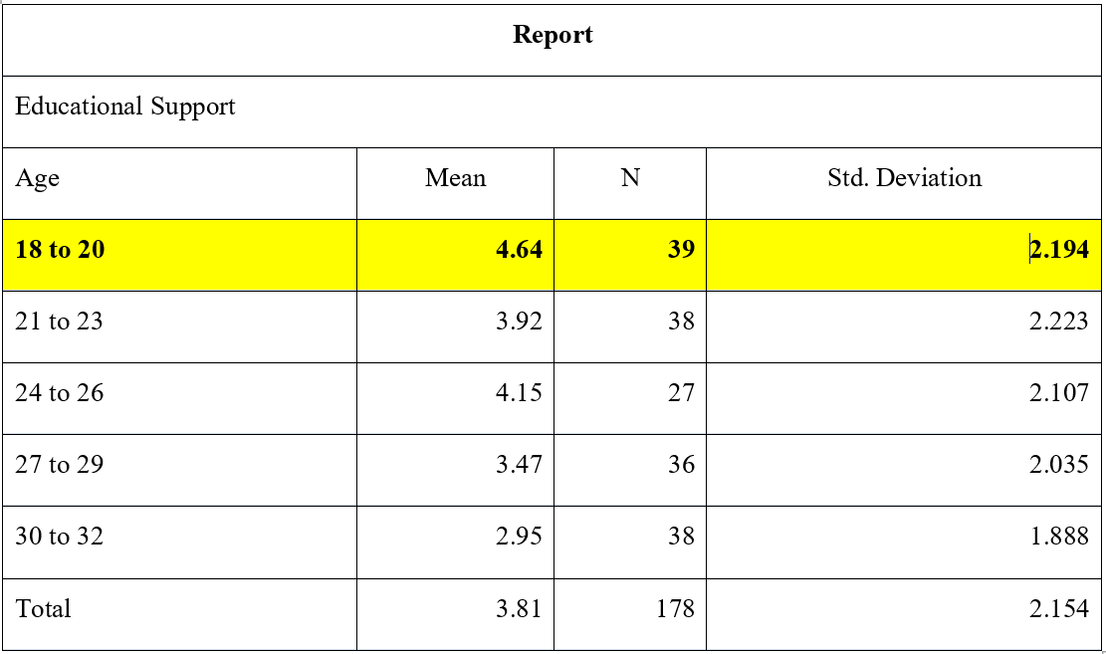
Analysis of Variance (Age)(cont.)
Assistance from Educators
Motivation

Slide 16
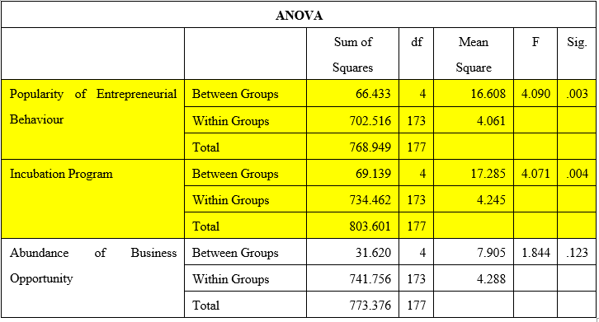
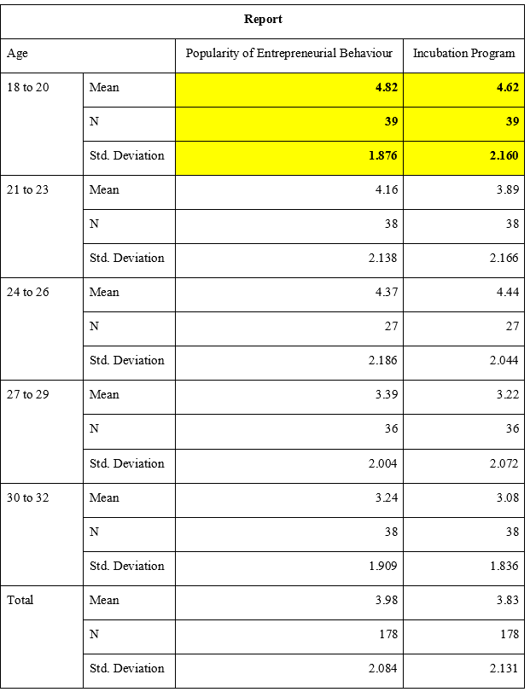
Analysis of Variance (Age)(cont.)
Environmental Factors
Motivation

Slide 17
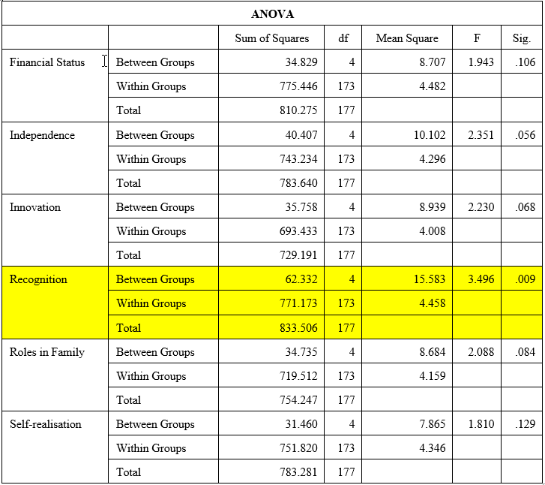
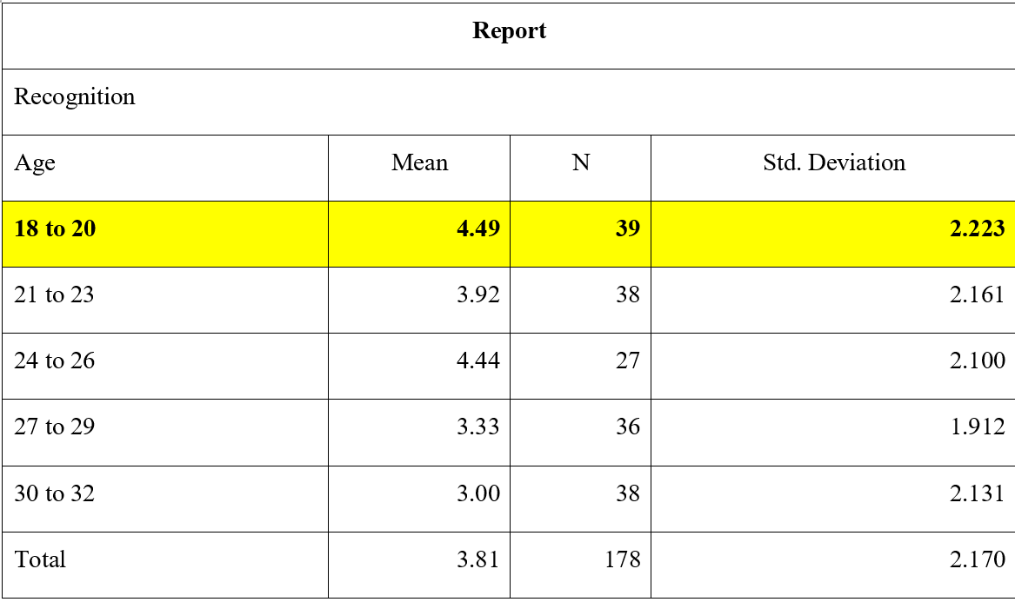
Analysis of Variance (Age)(cont.)
Factors from the Personal Attributes
Motivation

Slide 18
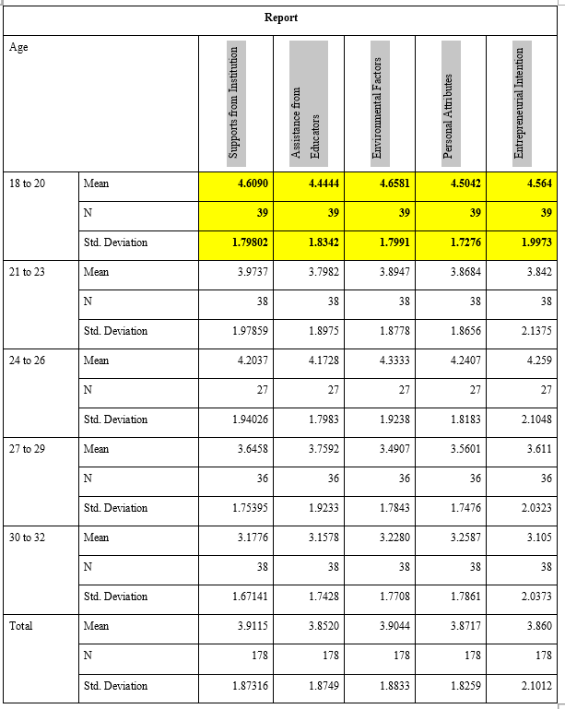
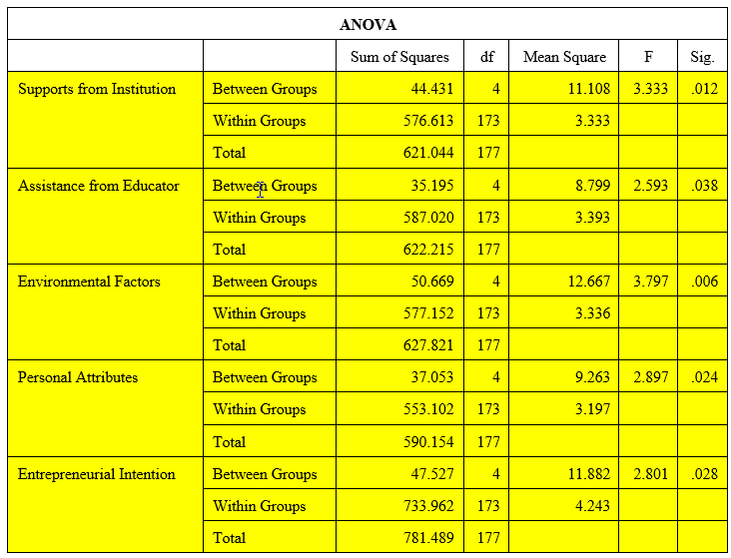
Analysis of Variance (Age)(cont.)
Four Categories & Entrepreneurial Intention
Motivation

Slide 19
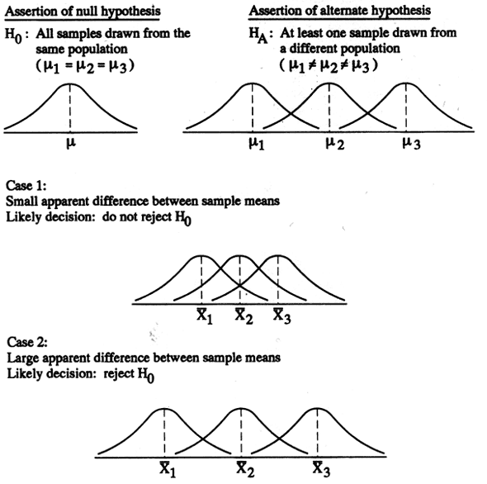
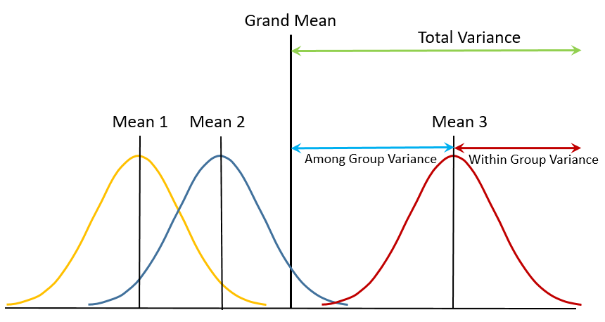
Analysis of Variance (Others)
All Sig. > 0.05
Shared Opinion
No Need for Separated Study!!
No Significant Difference
Motivation

Slide 20
Summary of Results
Support
Entrepreneurial Atmosphere
Confidence
Descriptive:
Personal Attribute
Encouragement
Recognition
Correlative:
Personal Attribute
Staring of New Business
Role of Family
Regressive:
Motivation
Age
Continuous Support
New Comers
Analysis of Variance:

Slide 21
Summary of Results (Cont.)
Symbol | Proven Hypothesis (Results from Statistical Analysis)
HA1_(Age) | There is significant dissimilarity for the opinion related to supports from institutions among different groups of Age.
HA1.1_(Age) | There is significant dissimilarity for the opinion related to financial incentive among different groups of Age.
HA1.2_(Age) | There is significant dissimilarity for the opinion related to acting as guarantor among different groups of Age.
HA1.4_(Age) | There is significant dissimilarity for the opinion related to the provision of reference materials among different groups of Age.
HA2.1_(Age) | There is significant dissimilarity for the opinion related to educational support among different groups of Age.
HA3.1_(Age) | There is significant dissimilarity for the opinion related to the popularity of entrepreneurial behaviour among different groups of Age.
HA3.2_(Age) | There is significant dissimilarity for the opinion related to incubation program among different groups of Age.
HA4.3_(Age) | There is significant dissimilarity for the opinion related to innovation among different groups of Age.
Motivation

Slide 22
Recommendations
Mentoring Program
Intention
Social Environment
Internal Determinants
Encouragement
Blind Resource
Mismatch
Promotion & Advertisement
Better Information
Motivation

Slide 23
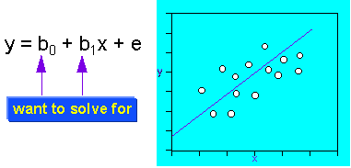
Future Study
Constructs 1
Constructs 3
Constructs 2
Age 1
Age 2
Age 3
……
Age N
Motivation

Slide 24
Thank You!!
The End
Question & Answer

Slide 25
Meanings of Determinants
Supports from Institution
Financial Incentive
Acting as Guarantor
Technological Support
Provision of Reference Materials
Assistance from Educator
Educational Support
Concept Development Support
Business Development Support
Motivation

Slide 26
Meanings of Determinants (Cont.)
Environmental Factors
Popularity of Entrepreneurial Behaviour
Incubation Program
Abundance of Business Opportunity
Personal Attributes
Financial Status
Independence
Innovation
Recognition
Roles in Family
Self-realisation
Motivation

Slide 27
Validity & Reliability
Validity
Skimming Through Process
Checking for Recurrent Pattern
Reliability
Cronbach's Alpha
Alpha Value > 0.6
Pilot Run
Motivation

Slide 28
Validity & Reliability (cont.)
Pilot Instrument
Inclusion of Declaration
Grammar Correction
Adding Contact Information
Motivation
Formal Instrument

Slide 29
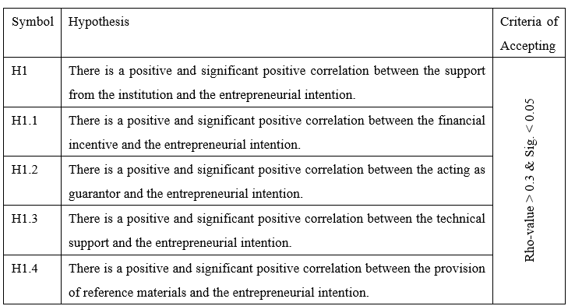
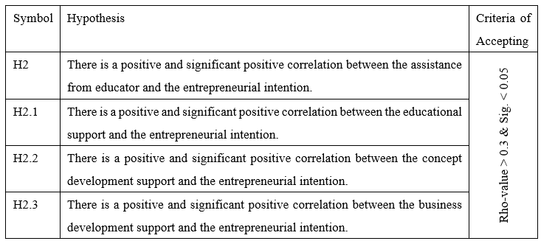
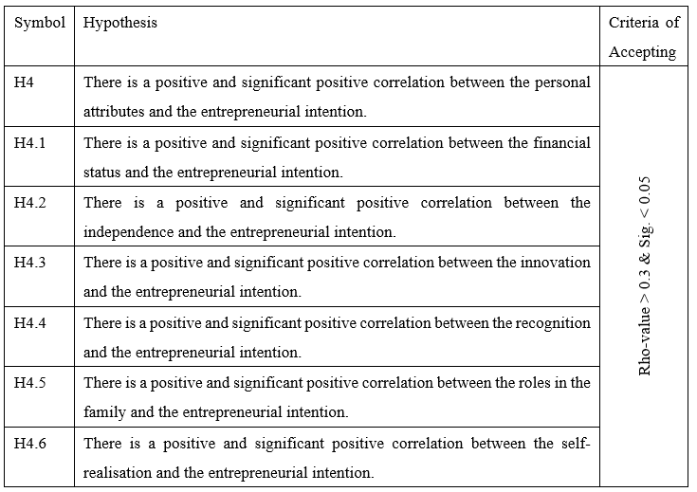
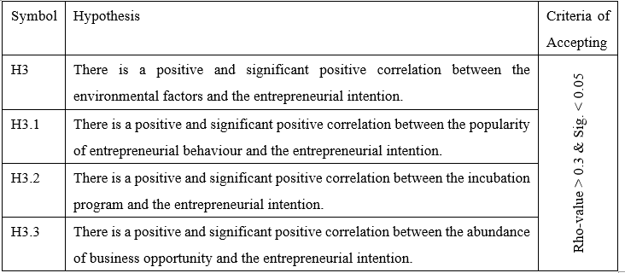
Hypotheses
Motivation

Slide 30
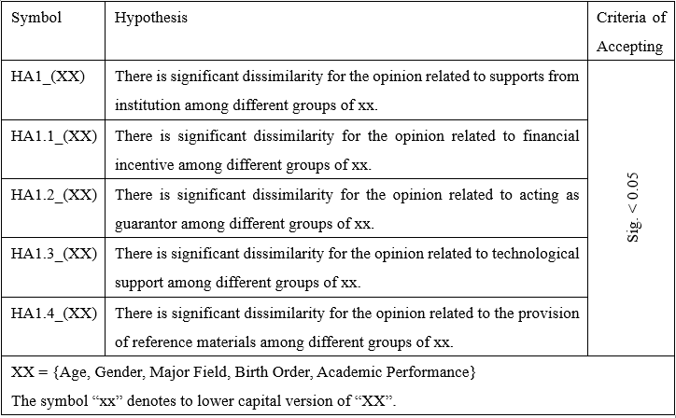
Hypotheses (cont.)
Motivation

Slide 31
Achievement of Study
Review of Situation
Construction of Model
Provision of Recommendations
Overview of Situation
Model Construction
Analysis Difference of Opinion
Performance of Correlative Analysis
Formulating the Intention
Motivation
Complete!!

