Slide 1
United Microelectronic Centre (HK) Ltd.
UMEC (HK)
Dr. MeiKei IEONG

Slide 4
ImageNet ILSVRC: Significantly improved by Deep Learning
Notes:
The ImageNet project is a large database for visual object recognition software research.
Since 2010, the ImageNet project runs an annual software contest, the ImageNet Large Scale Visual Recognition Challenge (ILSVRC),
where software programs compete to correctly classify and detect objects and scenes.
The ImageNet Challenge uses one thousand non-overlapping object classes.
A dramatic 2012 breakthrough is widely considered to be the beginning of the deep learning revolution.
human -like accuracy was achieved in 2014. Today, deep learning algorithm can achieve accuracy with super-human’s capability.
By the way, Universities in Hong Kong such as CUHK and HKUST were frequent winners in some categories of the competitions.

Slide 5
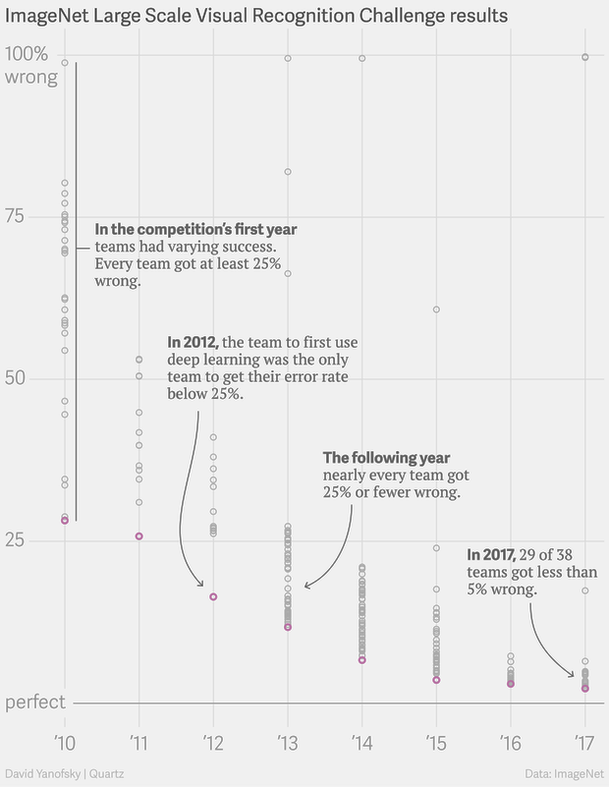
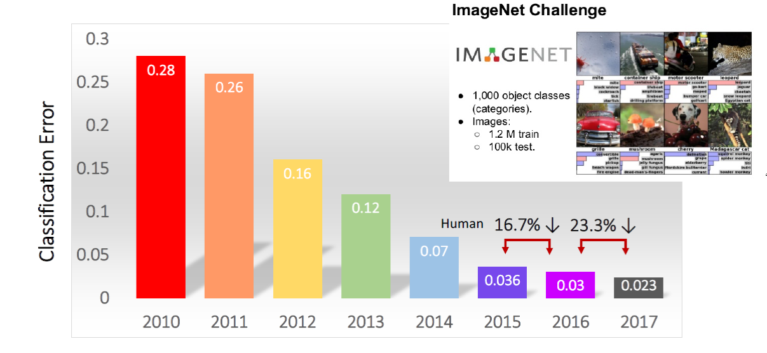
What the ImageNet ILSVRC Challenge tells us
*More Affordable Computing!
*Abundant of good Deep Learning Algorithm!

Slide 6
AI Driven by Computational Power, Algorithm & Data

Slide 7
AI is Ubiquitous
[Credit: SenseTime]

Slide 8
Advanced Manufacturing
Advanced Semiconductor Manufacturing Facility: Where are the workers?
Notes:
Industrial robots have been adopted in factories worldwide for more than 50 years.
Take Advanced semiconductor manufacturing as an example.
Automatic material handling system are connected to all the tools. It has been people-less for more than a decade.
You cannot find operator inside the fab.
Instead, many of the engineers and technicians are sitting inside a computer control just outside the fab to monitor all the processes and tools.
But this kind of automations are too expensive and not flexible enough for more traditional manufacturing often found in China.
With ever increasing wages, diminishing worker supply and shortened product life-cycle, Robots need to be more intelligent and flexible with reasonable cost.

Slide 9
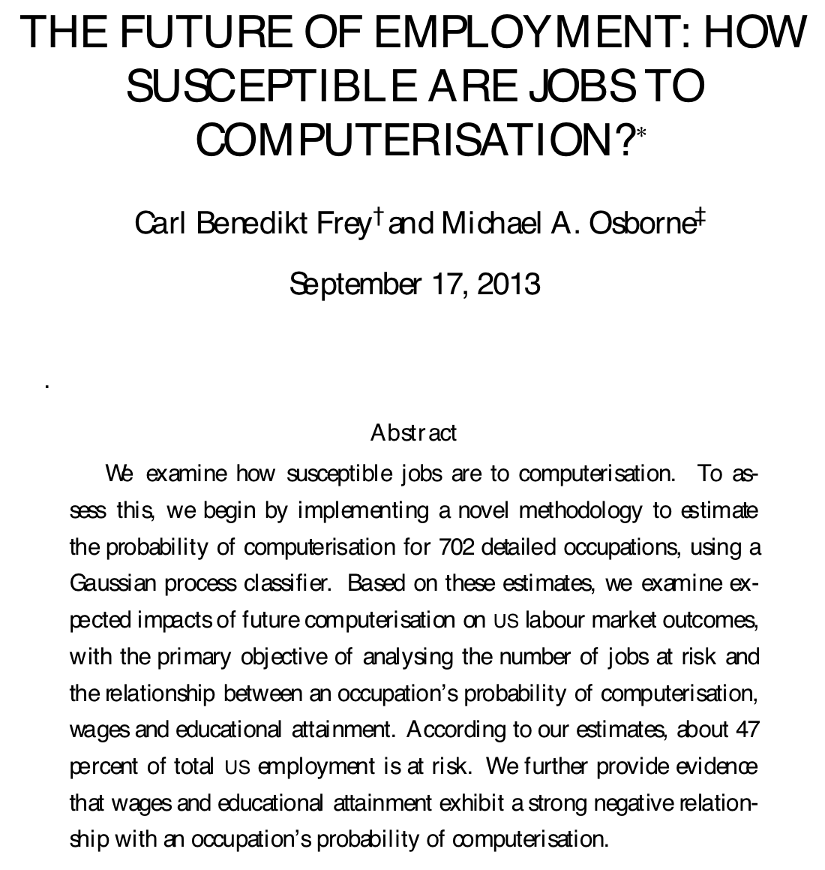
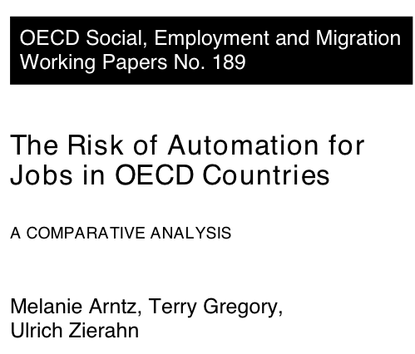
Potential Impacts of AI
[Oxford]
on average, only 9% of jobs are at risk
47% of jobs are automatable
Notes:
But we realize that many of these technology will inevitably impact jobs.
According to a paper published by Carl Frey and Michael Osborne from Oxford University,
47% of jobs are automatable from a technological capabilities point of view. 47% of jobs I the US will be at risk.
The OECD Social, Employment and Migration Working paper published in 2016 predicted a much lower number, on average, only 9% of jobs are at risk:
What are the reasons for the differences:

Slide 10
Adoption of new technologies is a slow process.
Workers can adjust to changing technology.
Technological change also generates additional jobs.

Slide 11
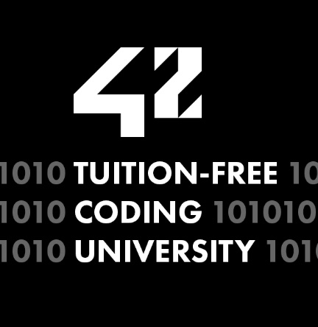
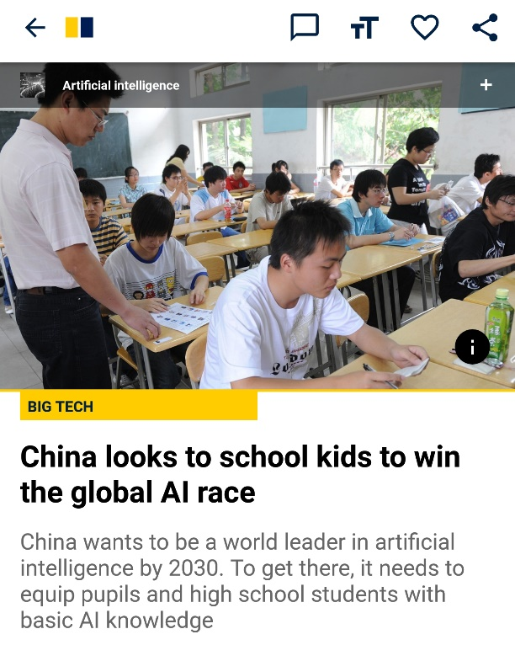
Talents, Talents, and lots of Talents!
Going back to the talent conundrum
New tools
New skills
New ‘Normal’
Talents to Perfect AI solutions
New models
Talents to Ensure legitimate and acceptable usage
Talents to Develop AI solutions
Knowledge and skills: The talent conundrum

Slide 12
AI Competitiveness: Talents and Computational Power
AI Researchers
Baidu
Google
Tencent
Microsoft
Amazon
Sensetime
IBM
Facebook
Alibaba
AI Chips & Accelerators
Notes:
人工智能时代的七巨头——谷歌、Facebook 、亚马逊、微软、百度、阿里巴巴和腾讯，都是中国或美国的公司，它们动辄花费数十亿美元建立惊人的数据储备，大量延揽人工智能精英，努力建立人工智能时代的公共设施它们正在为人工智能的未来发展铺设大范围的“电网”，即建设私有云和公有云的设施：使机器学习扩散到整个经济体系中。巨头们建立私有人工智能“电网”的现象，不仅令重视开放人工智能生态系统的人担忧，也是中国迅速崛起、成为人工智能超级大国的一块隐形绊脚石

Slide 13
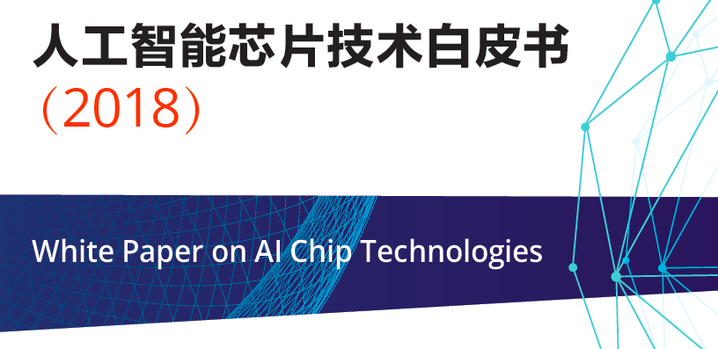
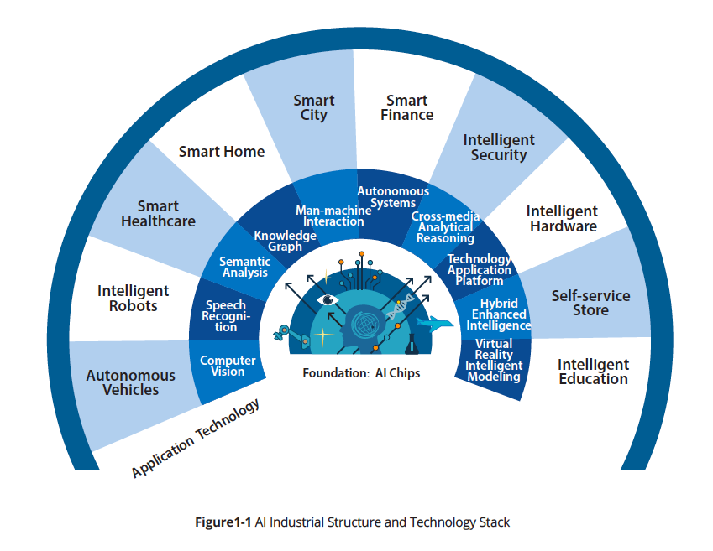
AI Research: New Era
AI chip is the foundation for the AI industry

Slide 14
~10X VC Investments last 2 years
[Walden Rhines]
Walden Rhines
Notes:
Many of the investments go to nurturing innovations in dedicated AI accelerators hardware because traditional computing architecture and current process technologies are not sufficient to support the future growth of AI applications.

Slide 15
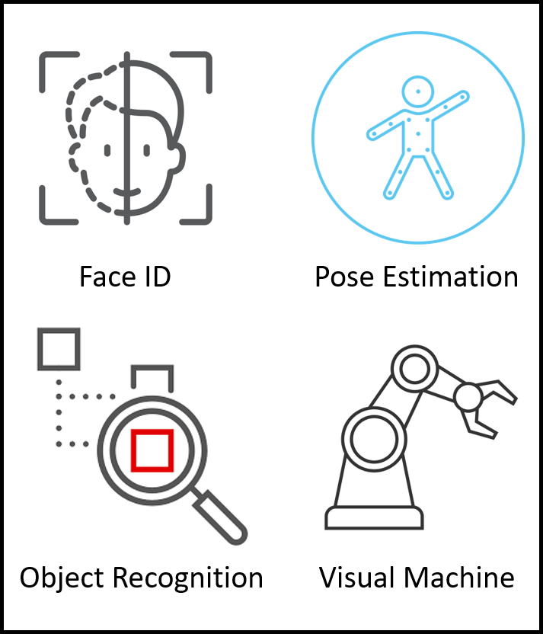
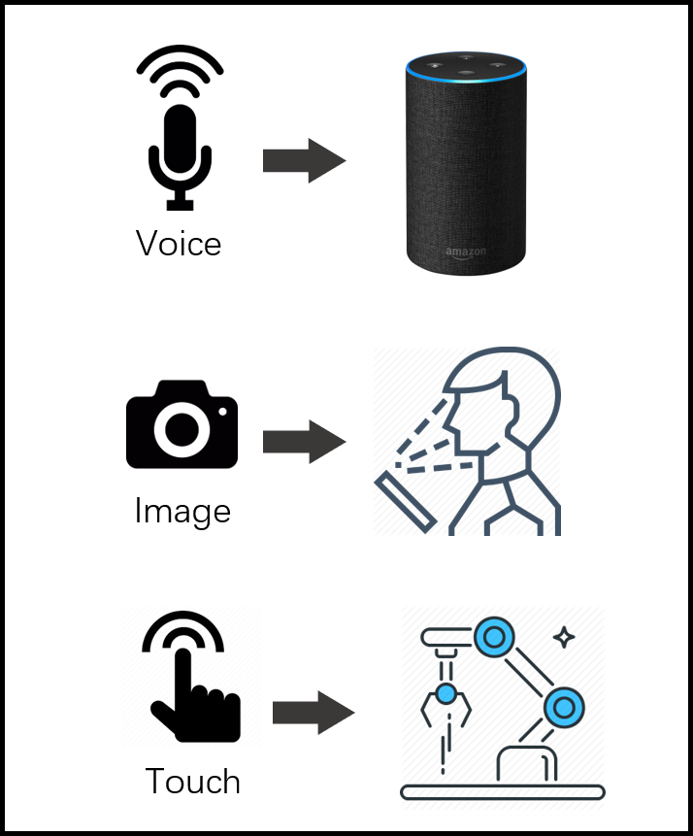
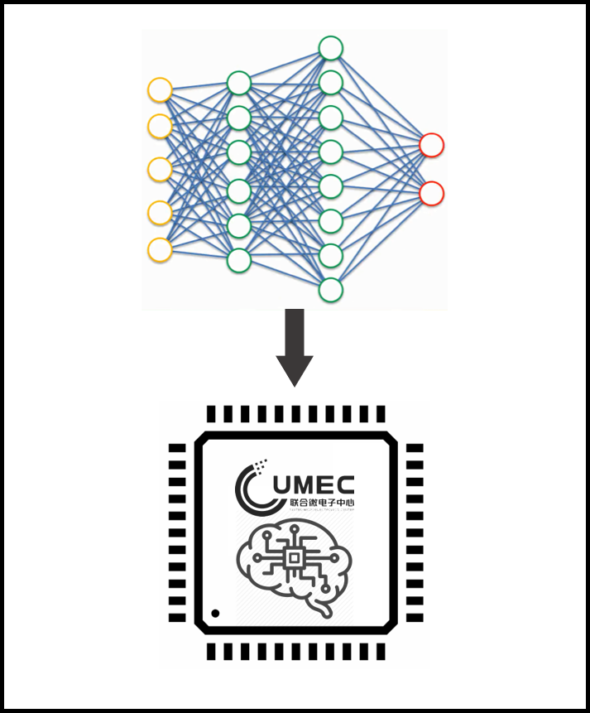
UMEC(HK) R&D
Innovative Model
AI Visual
AIoT
AI Chip

Slide 16
UMECHK Global Collaboration

Slide 17
Thank you
Contact Us
Dr. Mei Kei IEONG
mkieong@umechk.com
See u in HKSTP
UMEC(HK) Company Limited
© 2019

