Slide 1
Human entrepreneurship ecosystem on MSMEs development trough Halal Tourism

Slide 2
SMEs Challenging

Slide 3
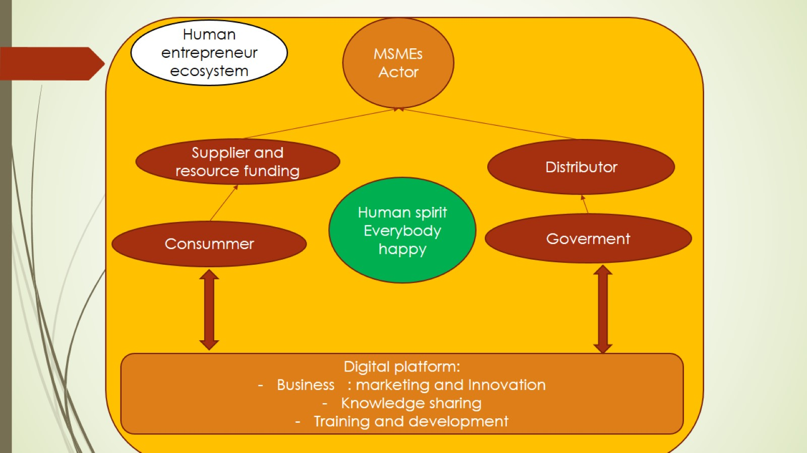

Slide 5
Tourism Geography

Slide 6
Rural Tourism

Slide 7
Sustainability

Slide 8
Sustainable Tourism

Slide 9
Digital Tourism actor network

Slide 10
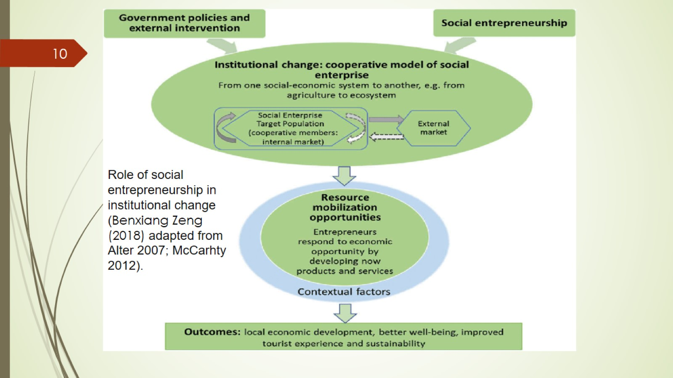

Slide 11
Ecotourism Development

Slide 12
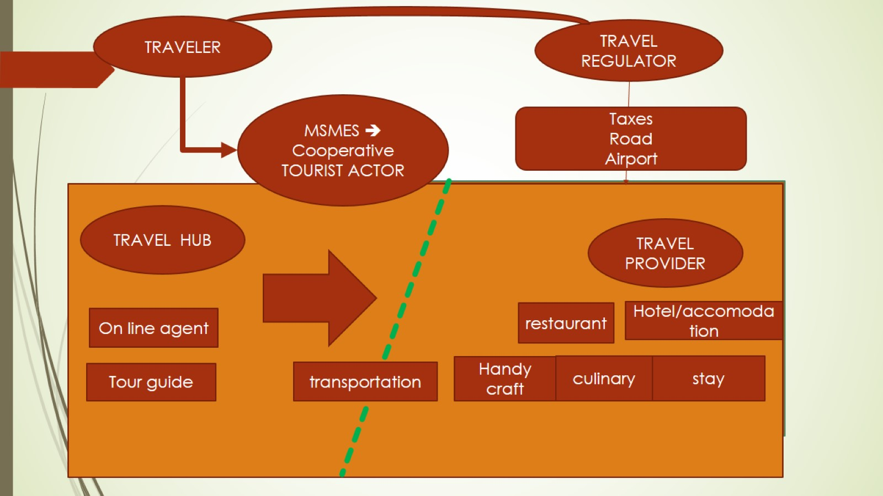

Slide 15
Masterplan Syariah Economic Indonesia

Slide 16
CRESCENTRATING ACES MODEL

Slide 17
Global Muslim Travel Index 2019

Slide 18
Wisata halal yang diinginkan wisatawan Indonesia (Survey 2018)

Slide 19
Halal dan Toyib

Slide 20
Train Night Market, Talad Neon, Pratunam

Slide 21
Malabar Corner

Slide 22
Trisakti School Tourist Milestone: Cibuntu Community-Based Tourism (Kuningan Regency)

Slide 23
MARTHA TILAAR GROUP

Slide 25
Bibliography

Slide 26
Acknowledgment

