Slide 1
Unfolding Opportunities Amid Global Supply Chain Transformation
13 Dec 2019

Slide 2
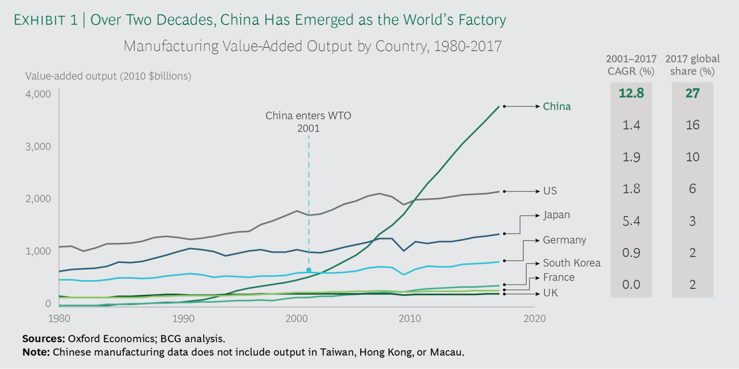
China – Global Manufacturing Hub
02

Slide 3
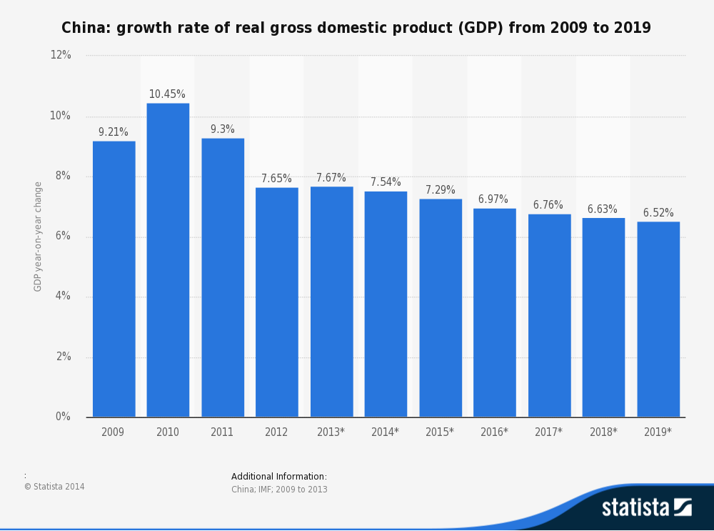
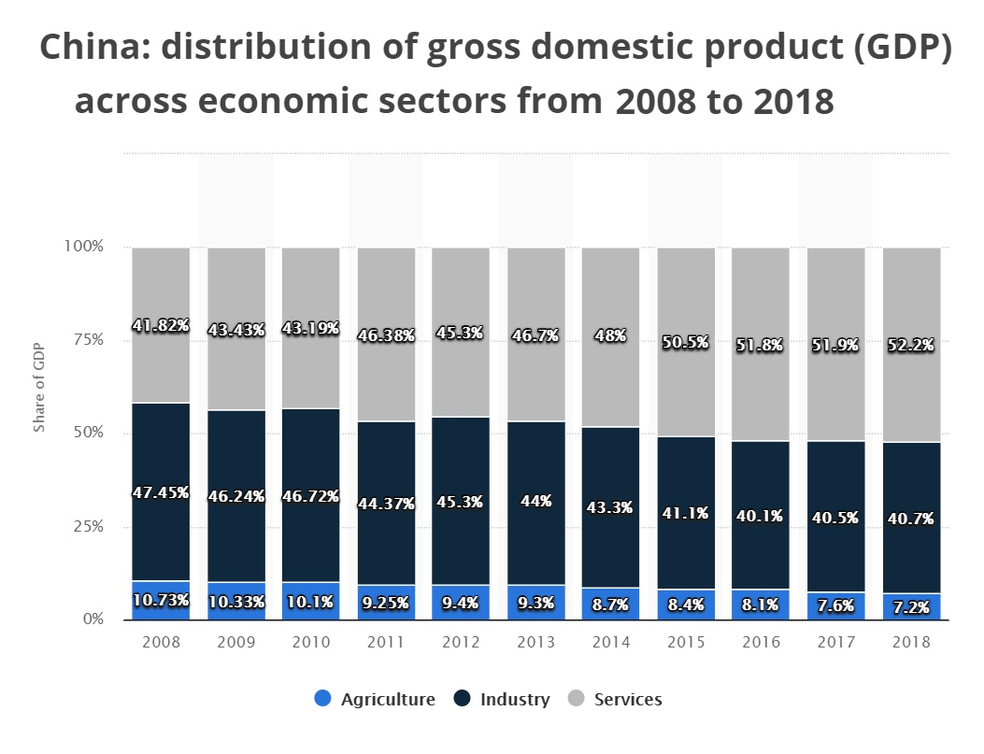
China – GDP Growth
03

Slide 4
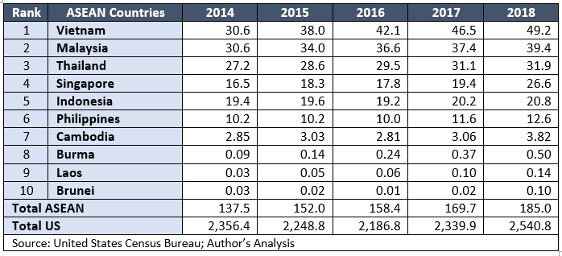
ASEAN – Sourcing Opportunities
04
US Imports from ASEAN Countries (US$ Billion)
Ref: https://asiapacificcircle.org/asia-pacific-insights-trends/us-china-trade-war-india-asean-opportunity/

Slide 5
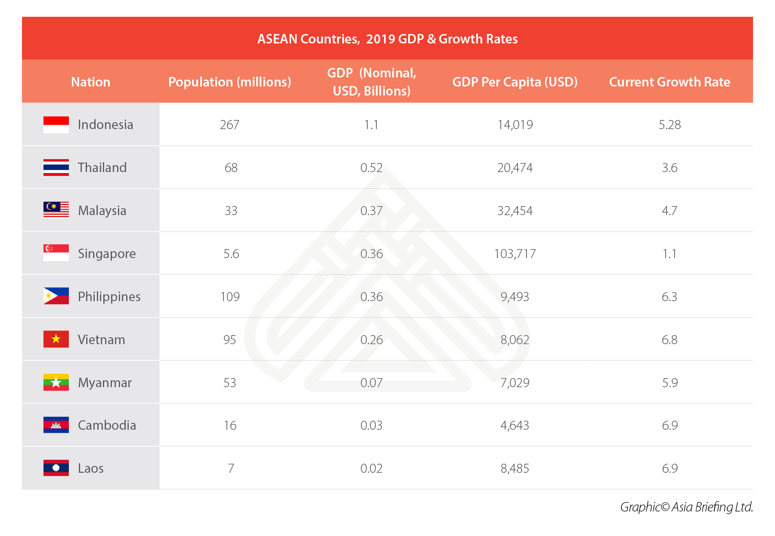
ASEAN – Market Growth
05

Slide 6
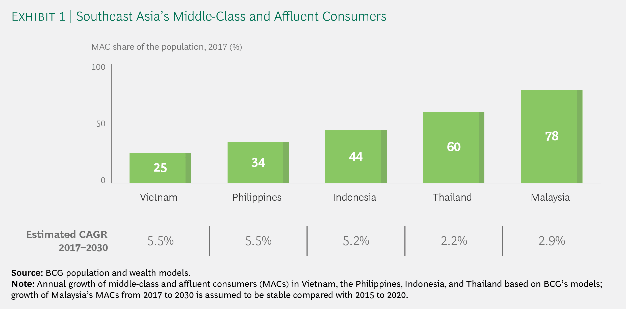
ASEAN – Middle Class
06

Slide 7
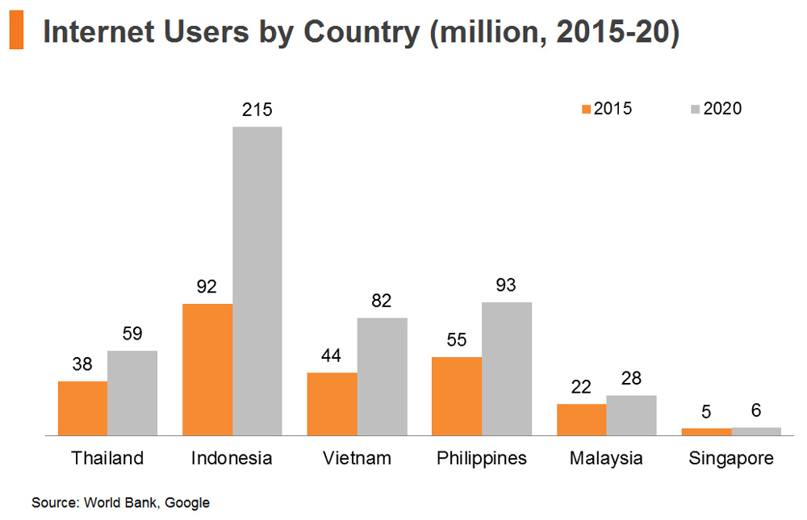
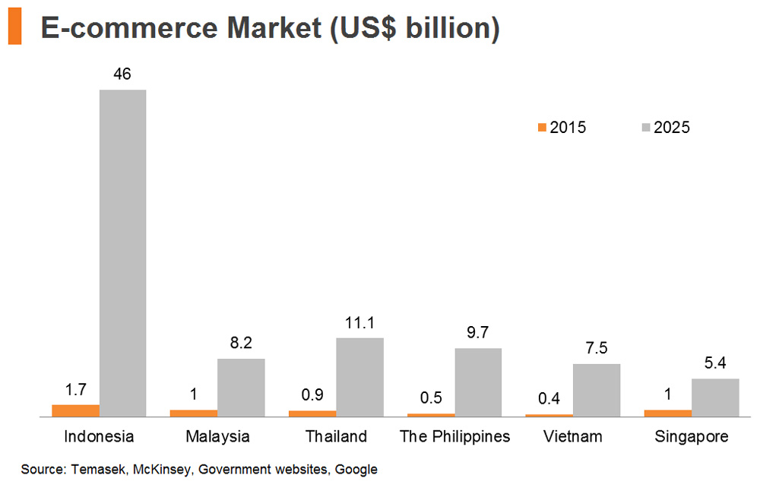
ASEAN – Digital Economy
07

Slide 8
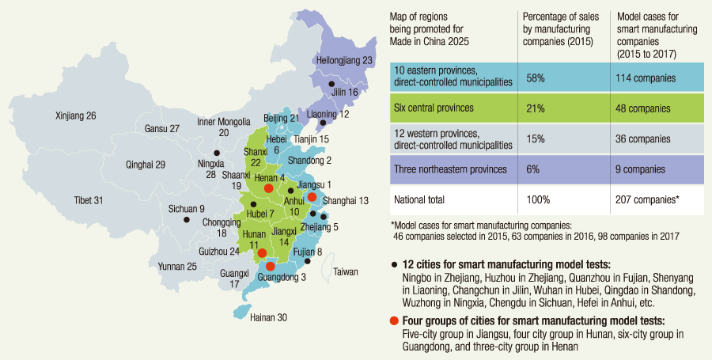
China – Smart Manufacturing
08
Source: www.hitachi.com/rev/archive/2018/r2018_02/gir/index.html

Slide 9
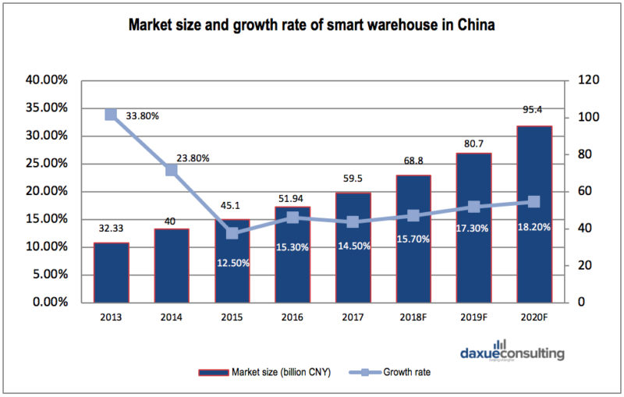
China – Smart Warehouse
09

Slide 10
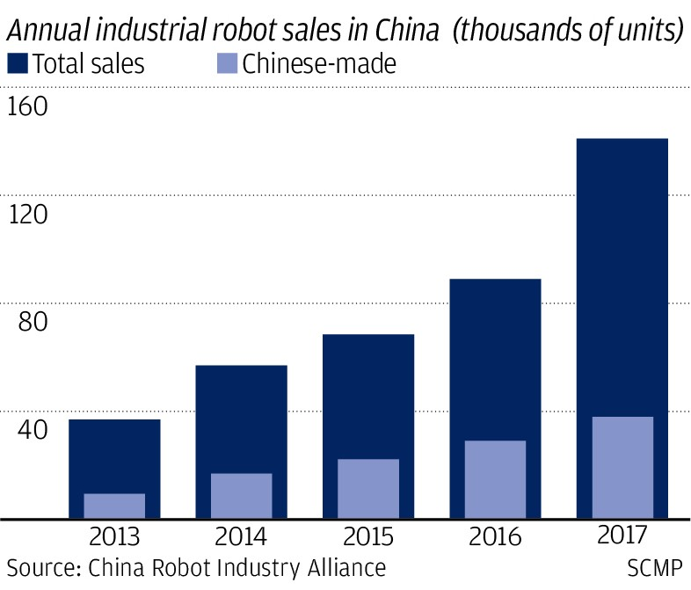
China – Industrial Robot
10

Slide 11
China – Smart Manufacturing Profitability
11
Source: Deloitte Smart Manufacturing Enterprise Survey 2018

Slide 12
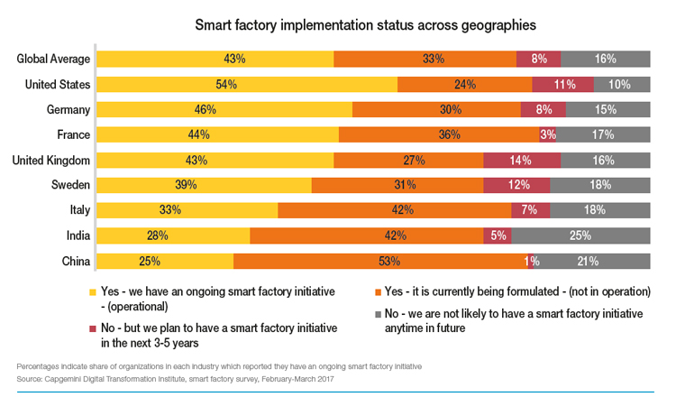
Global Smart Manufacturing Growth
12

Slide 13
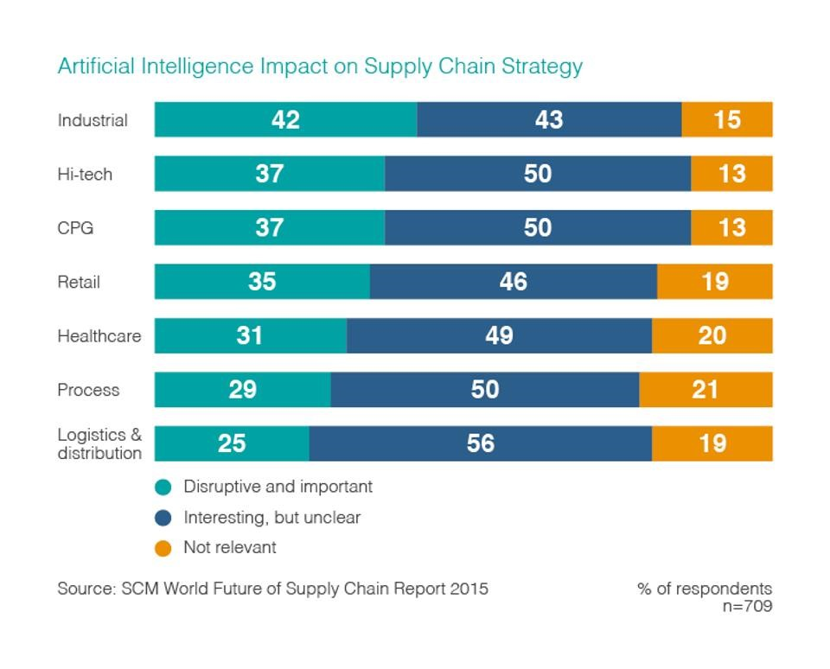
Supply Chain – AI Deployment
13

Slide 14
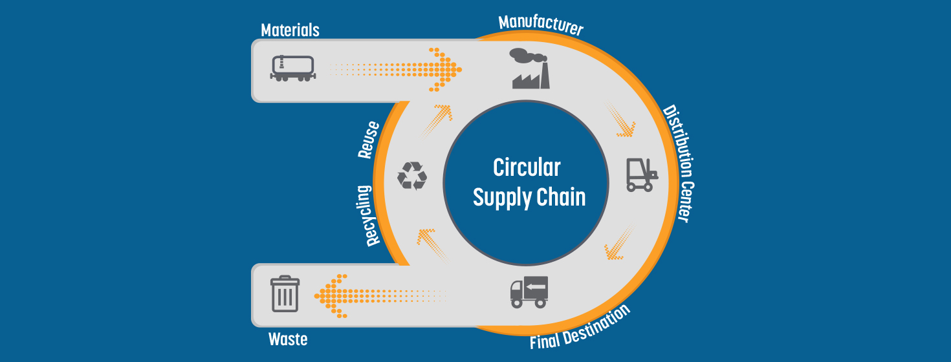
Circular Supply Chain
14
Source: www.supplychain247.com/article/circular_supply_chain_the_missing_link

Slide 15

Supply Chain – Technology Deployment
15
Source: www.computerworld.com/article/3249252/blockchain-will-be-the-killer-app-for-supply-chain-management-in-2018.html

Slide 16
16
Unfolding Opportunities Amid Global Supply Chain Transformation
For further enquiries, please contact:
Gordon Lo
Director-General
Federation of Hong Kong Industries
T: 2732-3183
E: gordon.lo@fhki.org.hk

