Slide 1
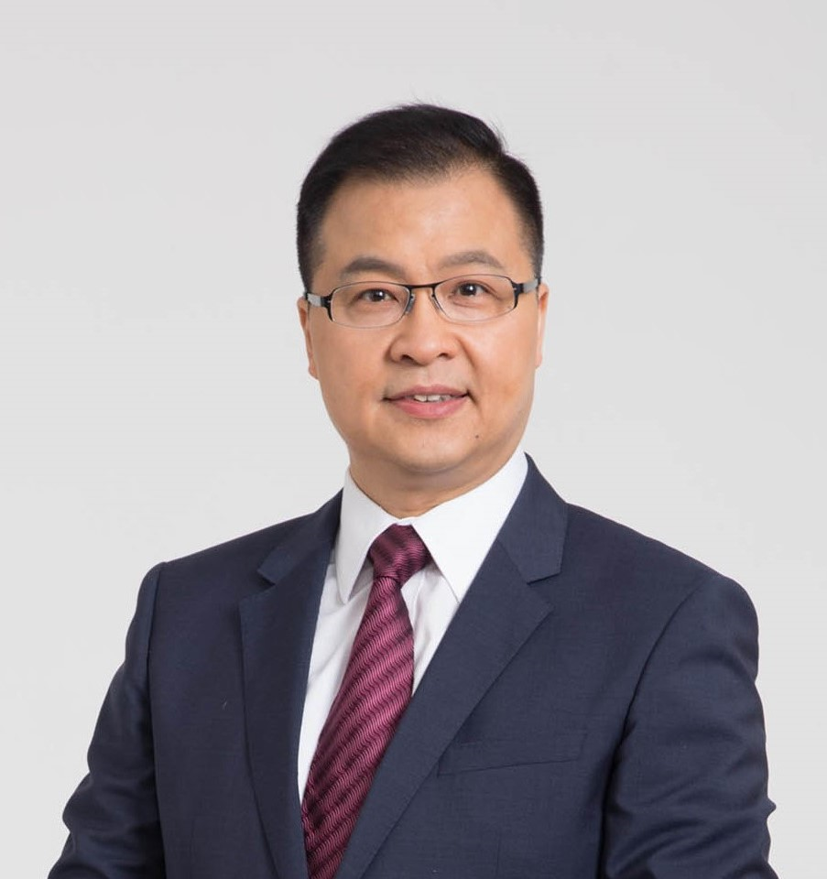
SME Forum - Supply Chain & Global Trade
Frank Y. C. Leung
Macau P. R.
Family Business Owner
Logistic Engineer (HKIE)
December 2019

Slide 2
Supply Chain & Global Trade
Supply Chain
Supply Chain Uncertainty
Global Trade
Least Developed Economy

Slide 3
Classification
1. Developed Economy. USA, Japan, EU
2. Developing Economy. China, India, Vietnam
3. Least-developed Economy. Djibouti, Ethiopia, Sudan

Slide 4
Why - Least Developed Economy
Problem
My experience

Slide 5
Global Trade of goods and services, (Export), 2009-2018
ECONOMY | Countries & Regions | 2009 | 2010 | 2011 | 2012 | 2013 | 2014 | 2015 | 2016 | 2017 | 2018
World | 232
Developed economies | 43 | 60% | 57% | 55% | 54% | 54% | 55% | 56% | 57% | 56% | 55%
Developing economies | 142 | 40% | 42% | 44% | 45% | 45% | 44% | 44% | 42% | 43% | 44%
LDCs economies | 47 | >1% | >1% | >1% | >1% | >1% | >1% | >1% | >1% | >1% | >1%
Sources from: https://unctadstat.unctad.org/wds/ReportFolders/reportFolders.aspx

Slide 6
The 2015 APEC Economic Leaders’ Declaration
They made a call to improve the economics development for the least developed countries

Slide 7
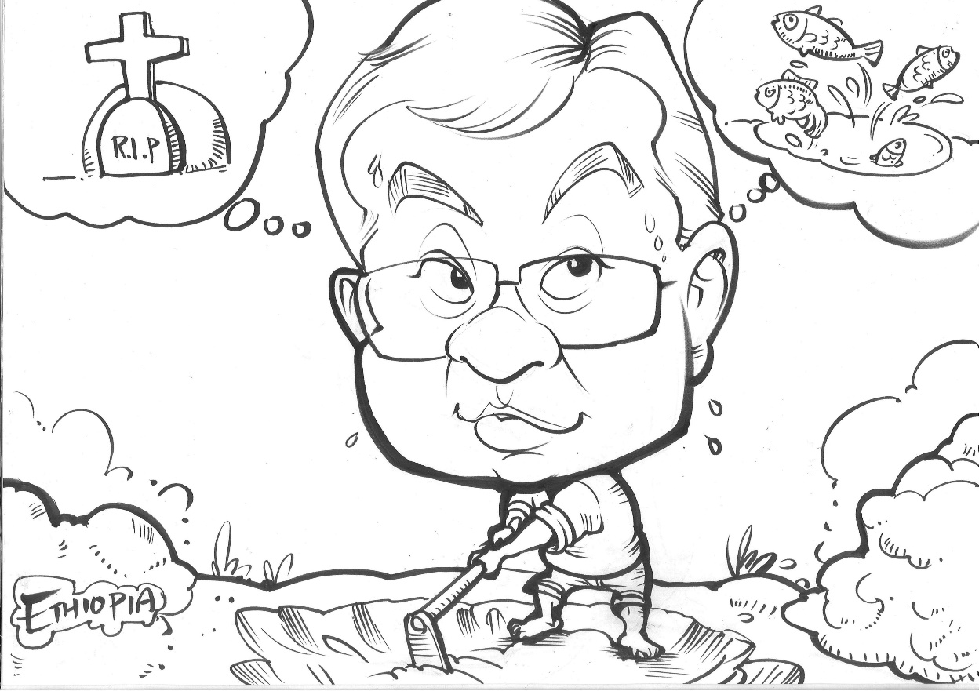

Slide 8
Report on Large and Medium Scale Manufacturing and Electricity Industries Survey in 2016
Top 3 major problems facing by companies in Ethiopia
1. Shortage of supply of Raw Materials
2. Shortage of Spare Parts
3. Getting Market / Customers

Slide 9
Poor Infrastructure Poor transportation
1. Shortage of supply of Raw Materials
2. Shortage of Spare Parts
3. Getting Market / Customers
Supply Chain uncertainty

Slide 10
OLI Theory- Location Disadvantage
Lack of component & material supply
Poor infrastructure
Transportation

Slide 11
Christine Lagarde
President of European Central Bank
Former Managing Director of IMF

Slide 12
Dec 2017, Managing Director of (IMF), Christine Lagarde visit Ethiopia and comment……
“important to reduce the burden on the public sector to provide infrastructure services.”
“overemphasis on infrastructure investments without substantial increases in the in the production of basic goods and services to deal with supply-side constraints”

Slide 13
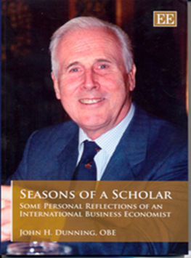
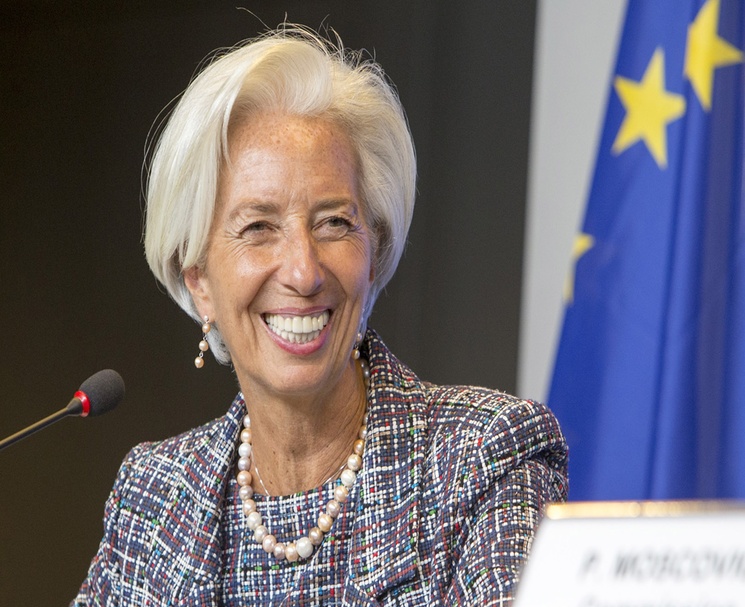
Supply Chain
John Dunning
Remove location disadvantage
Reduce infrastructure
Christine Lagarde

Slide 14
Where is Ethiopia

Slide 15
Remove Supply Chain uncertainty in the Least Developed Country
Thank you

