Slide 1
The Greater Guangdong-HK-Macao Bay Area: Challenges and Opportunities
Edward K Y Chen 陳坤耀教授
Chairman of HKU SPACE (School of Professional and Continuing Education), Former President of Lingnan University and of Qianhai Institute for Innovative Research (Shenzhen)
SME World Forum
Macao, 12-13 December 2019

Slide 2
The Guangdong-HK-Macao Greater Bay Area
Not a new concept; previously promulgated at the municipal and provincial level in the context of the further development of the Pearl River Delta (2009, 2010)
What is new:
A central government directive - (NDRC, 9/2015; Premier’s government work report, 3/2017; GBA steering committee meeting 8/2018)
Part of a ‘new’ national economic development strategy for Second Opening Up to deal with ‘middle-income trap’
An international development strategy embedded in the B&R Initiative (3/2015)

Slide 3
The 9 + 2 Greater Bay Area
A concept based on other Bay Area economies:
The San Francisco Bay, the New York Bay, the Tokyo Bay
The 9 + 2 includes
Hong Kong SAR and Macao SAR
廣州 (Guangzhou)、惠州 (Huizhou)、東莞 (Dongguan)、 深圳 (Shenzhen) on the east
肇慶 (Zhaoqing)、佛山 (Foshan)、中山 (Zhongshan)、 江門 (Jiangmen)、珠海 (Zhuhai) on the west

Slide 5
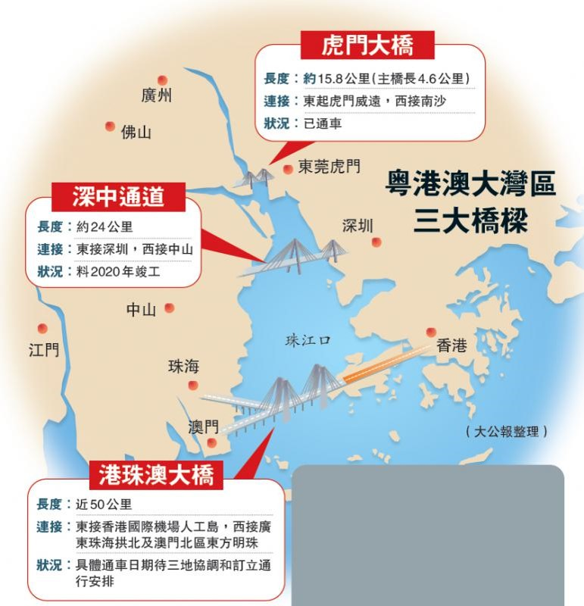

Slide 6
G-HK-M Greater Bay Area - Rationale
A key role in the second economic transformation/structural change emphasising modern service industries: Finance, Innovation & Technology, Logistics, Professional & Technical Services
Further development of the Pearl River Delta with HK, Shenzhen, and Guangzhou as key drivers
2. Strengthening the Guangdong Free Trade Zones (FTZs)
Supporting the Maritime Silk Road, a doorway to Southeast and South Asia (westward and southbound)

Slide 7
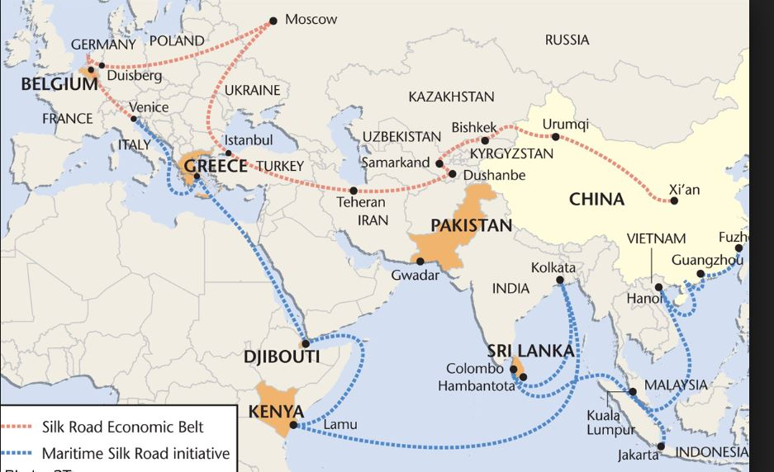

Slide 8
From FTZs to Greater Bay Area
Free Trade Zones (FTZs): initially Shanghai, Fujian, Tianjin
Cooperative Zone: Shenzhen Qianhai-Hong Kong
Guangdong FTZ – 3 Sub-Zones
Additional FTZs
Guangdong-HK-Macao Greater Bay Area

Slide 9
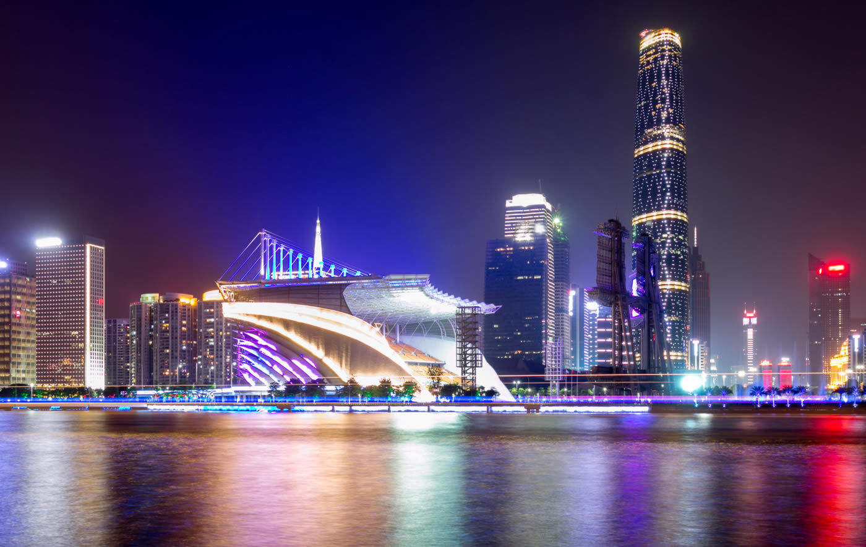

Slide 10
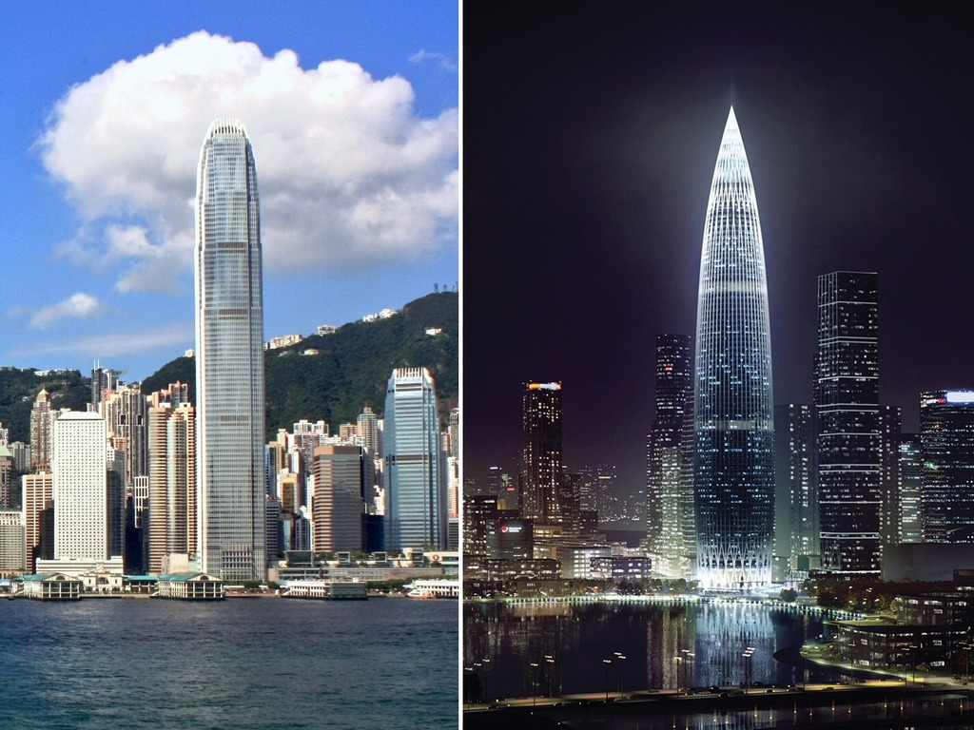

Slide 11
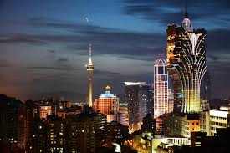

Slide 12
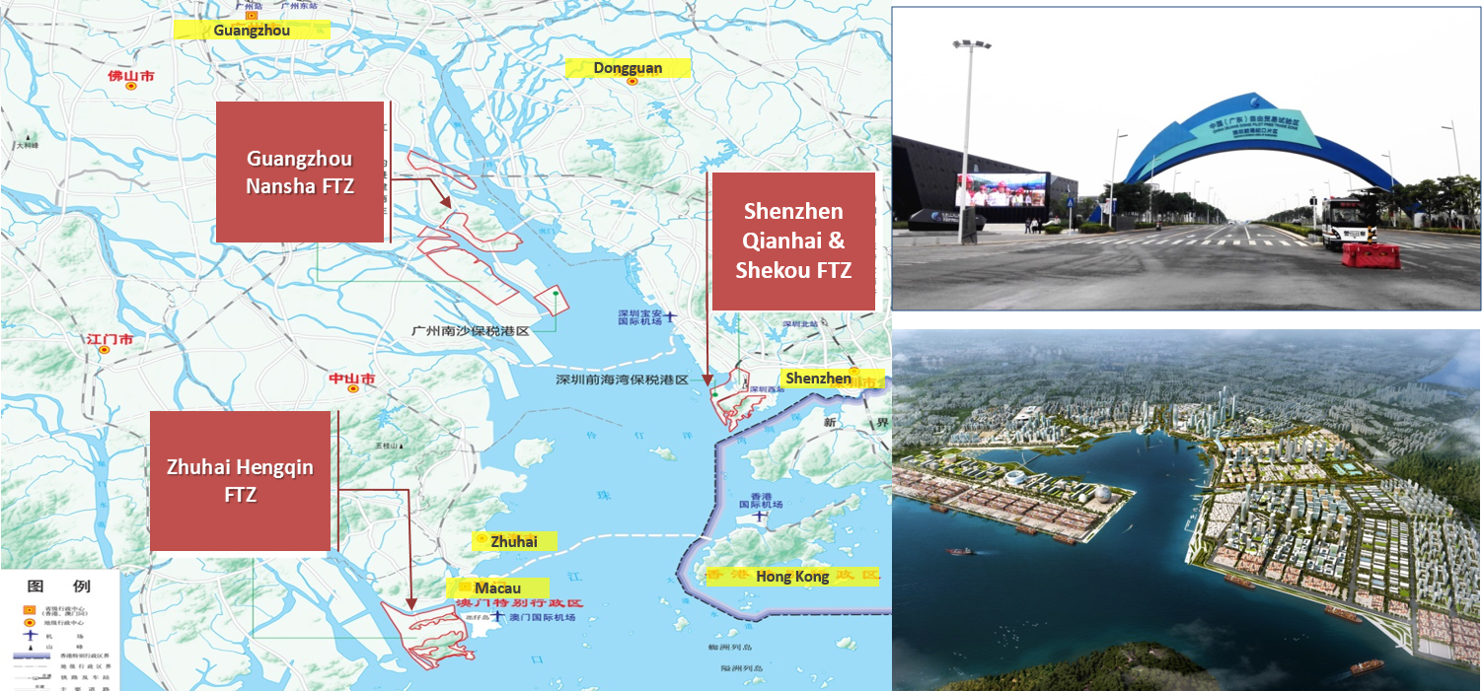

Slide 13
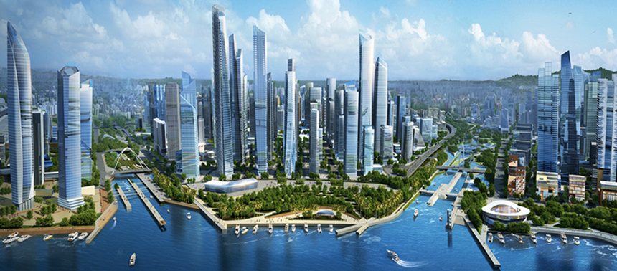

Slide 14
Positioning of 9 + 2
Modern services: Hong Kong, Shenzhen
Innovation & Technology: Hong Kong, Shenzhen, Dongguan(?), Zhuhai (?)
Recreation and Entertainment: Macao, Zhuhai
Heavy Manufacturing: Guangzhou, Huizhou
Light Manufacturing: Dongguan, Foshan, Zhongshan, Jiangmen
Primary Industries: Zhaoqing
Doorways: Jiangmen and Zhaoqing to ASEAN ; Hong Kong to the world; Zhongshan between the east and west coast of the Pearl River; Macao to Portuguese speaking countries

Slide 15
Opportunities offered by the GBA
The GBA, with almost 70 million people and an average growth rate of 8-9 %, and primary, secondary and tertiary industries already well-established, is no doubt investment worthy.
A high degree of complementarity and therefore synergy among the cities.
The greatest opportunities: financial services, innovation and technology, smart city, education and health (also challenges), reindustrialization (China 2025), establishing regional headquarters.

Slide 16
The Making of a Greater Bay Area
The Three ‘I’s:
Interactive activities (economic, social and cultural)
Interconnectedness (infrastructure, physical and cyber)
Interflows of resources (capital, people, goods & services, information)
Action agenda and plans needed to forge ( the 3 Cs):
Cooperation, Coordination and Competition.
Towards a Common Market not just a super FTZ.
Recent policy initiatives – work permit, residence permit, tax concessions, recent 16 policy measures (towards national treatment for HK and Macao residents)

Slide 17
Challenges and Recommendations
Three borders; Three systems; Three drivers (hubs)
Governance, Co-ordination and Implementation
A Bay Area Development Council (central and local governments)
A Bay Area Cooperative Council (private sector)
A Bay Area Economic Institute (think tank)
An annual GBA Summit (tripartite and international)

Slide 18
Thank You
Edward K Y Chen, ekychen@hku.hk

