Slide 1
Macau Small and Medium Enterprises World Forum Theme 1 – Fintech & Security
Christopher Hui
Executive Director
12 December 2019

Slide 2
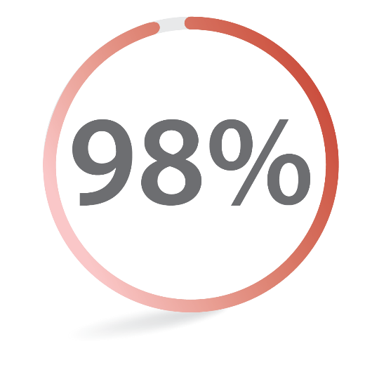
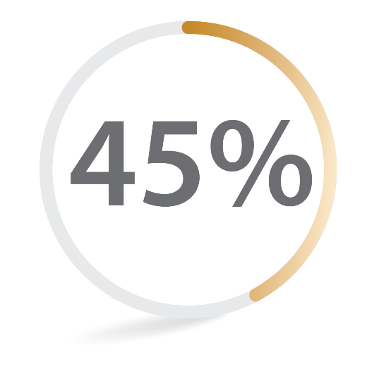
FinTech is highly relevant to SMEs
In Hong Kong, SMEs contribute to
S ecurity
of total business units
M obility
E fficiency
of total employment (excluding civil service)

Slide 3
FSDC’s work on FinTech
Five Key Areas:
Cybersecurity
Payments and Securities Settlement
Digital ID and KYC Utility
WealthTech and InsurTech
RegTech

Slide 4
Within FinTech, cybersecurity is a key element…
Globally (2018)
Hong Kong (Q1-Q3, 2018)
Surveyed enterprises each faced
13millon
256millon+
US$
US$
Average cost of cybercrime
(+12% YOY change)
Total amount of cybercrime loss
145
9,000+
Average number of security breaches
(+11% YOY change)
Cyberattacks in total
Source: Accenture, Telstra Security

Slide 5
Robust cybersecurity framework is needed
1
well-structured cybersecurity policy and strategy
2
cybersecurity culture
Key
Components
3
education, training and skills
4
an effective set of legal and regulatory framework
5
standards, organisations and technologies

Slide 6
Thank you

