Slide 1
Trends in Entrepreneurship Education & Research
Dr. Charles H. Matthews
Distinguished Teaching Professor
Fellow of the Graduate School
Founder, UC Center for Entrepreneurship
J. William Fulbright U.S. Scholar
University of Cincinnati
ICSB Past President and Chair of the Wilford L. White Fellows
13 December 2019

Slide 2
“Welcome to ever evolving world of Entrepreneurship Education and Research.”
©Charles H. Matthews, PhD

Slide 3
Three Key Points
Changing nature of work
Changing Nature of Education
The Entrepreneurship Paradox
What is next? What is next after next?
©Charles H. Matthews, PhD

Slide 4
√ Innovation is a moving target √ Conflicting information √ MSME vs Scalable Venture
Blockchain Centre, Vilnius, Lithuania ©Charles H. Matthews

Slide 5
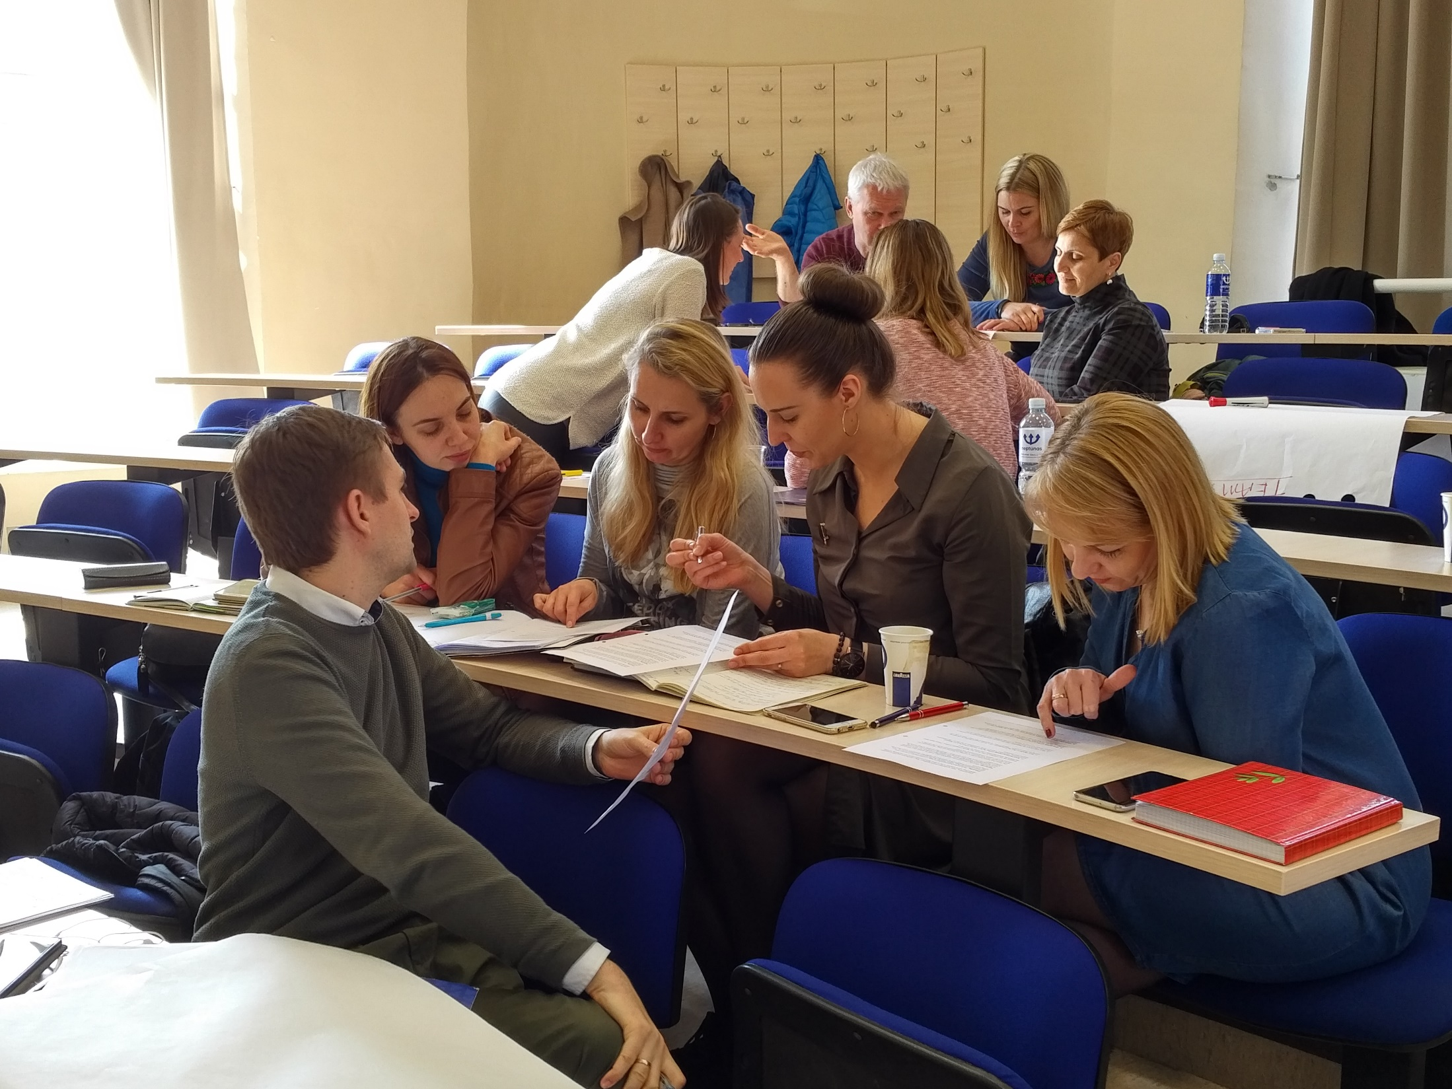
What is next?
Ideation, Integration, and Execution: State of the Art
What teaching/learning designs do we need to create value for our students?
Leadership and Teamwork Symposium
©Charles H. Matthews

Slide 6
What teaching/learning designs do we need to create value for our students?
Leadership and Teamwork Symposium
©Charles H. Matthews

Slide 7
Artificial Intelligence
Virtual Reality
Robotics
The Internet of Things (IoT and IIoT)
The Power of Big Data and Data Analytics
Access to Capital
Receptivity to Disruptive Innovation
Seven Key Trends
Katedros aikštė Vilnius, Lietuva atkuta 100 Celebration ©Charles H. Matthews

Slide 8
Questions and Answers
Where is Lithuania? ©Charles H. Matthews, PhD

