Slide 1
Women Entrepreneurship and Humane Entrepreneurship
13th December 2019

Slide 2
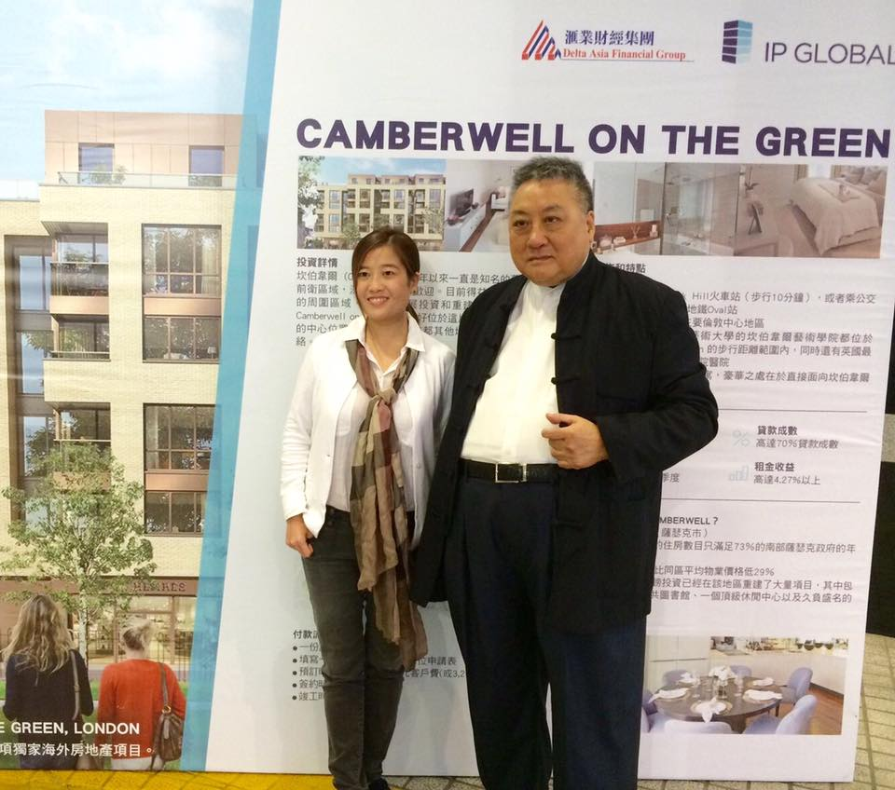

Slide 3
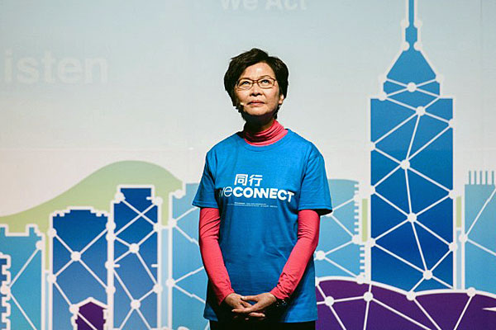
Women in Politics
Source: Tiroler Tageszeitung; ABC.net.au; rfa.org

Slide 4
Harvard Business School performed a survey in 2011
Leader’s overall effectiveness
Their leadership competencies.

Slide 5
MSCI
Women on boards Corporate productivity.
McKinsey
Companies with gender diverse executive teams are 21% more likely to outperform on profitability.

Slide 6
2.2% of venture capital funding in the U.S. went to companies founded solely by women
10% went to companies with at least one female founder.
Fortune magazine, 2018

Slide 7
Women and men are just Different

Slide 8
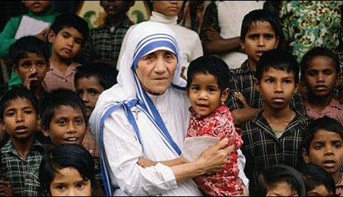
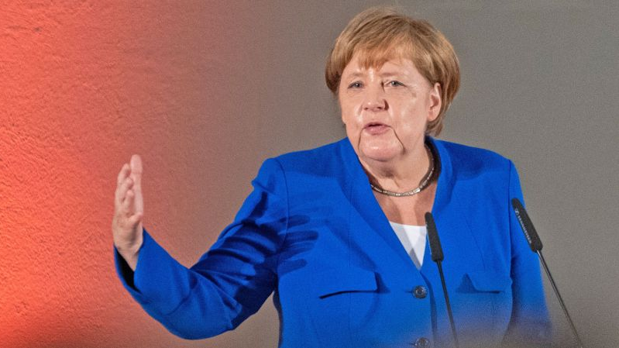
Great, but different Style of Leaders.
Source: Google

Slide 9
Company needs to be Responsible to Society to be a Long-term Winner

Slide 10
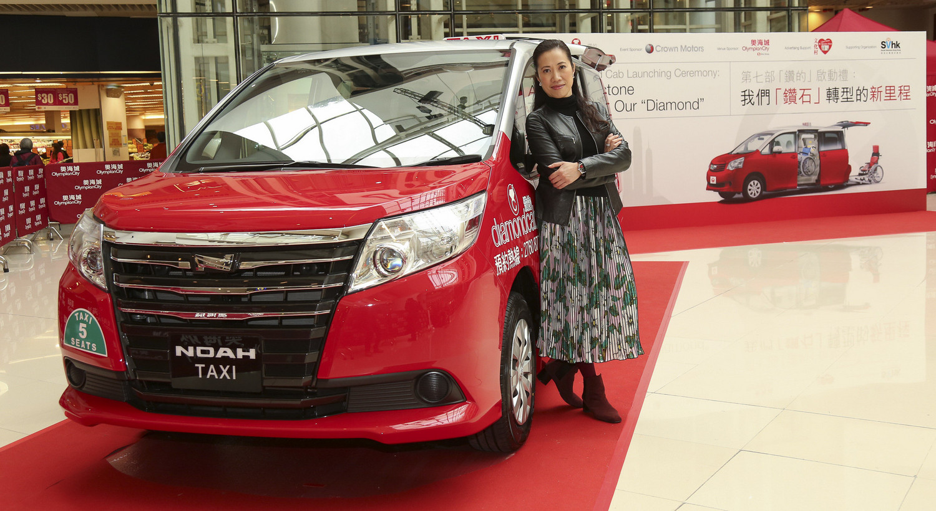

Slide 11
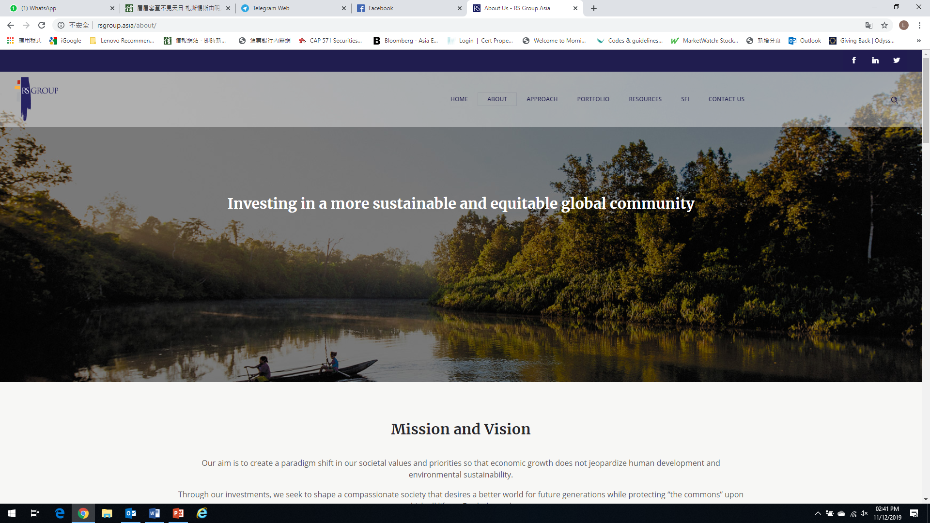

Slide 12
3 Things that I have learned:
The world is moving in such a pace and complexity that only leaders who are compassionate can embrace the needed diversities to outperform
Businesses are required to be entrepreneurial and think about the bigger social good in order to thrive in the long run
As women leaders, can and should choose to lead differently based on who we are.

Slide 13
Each one of us can Lead in Our Own Unique Way

Slide 14
Thank you

Slide 15
Contact Us
Hong Kong Office
5/F, Luk Kwok Centre,
72 Gloucester Road,
Wanchai, Hong Kong
Tel: (852) 2533 0800
www.delta-asia.com
香港總行
香港 灣仔告士打道72號
六國中心5樓
電話：(852) 2533 0800
www.delta-asia.com
Macau Office
No. 39-41, Rua do Campo,
Macau
Tel: (853) 2855 9898
滙業銀行中心 澳門水坑尾街39-41號 電話：(853) 2855 9898

